Slide 1

Get Crackin’ with Git Using GitKraken

Slide 2
Using your Web Browser,
Open this URL:
Click on the workshop you’re attending, and find:
1
http://mlhlocal.host/lhd-resources
2
Setup Instructions
The Code Samples
A demo project
A Workshop FAQ
These Workshop Slides
More Learning Resources
Notes:
What to Say:
Tell attendees we are going to check them in for the event
Once attendees check in, they will receive an email with the items listed on the slide
Attendees must check-in to get credit for attending this event
What to Do:
Confirm that everyone has checked in by asking participants to give you a signal when they receive the email.

Slide 3



+
Get Crackin' with Git using GitKraken!
This presentation was created
in partnership with MLH
Whose mission is to empower hackers!
65,000+
HACKERS
12,000+
PROJECTS CREATED
3,000+
SCHOOLS

Slide 4

Why are we here?
How many people here have had to collaborate on a code project before and weren't sure how to go about it?
How many of us have used Git/GitHub or other tools to collaborate and felt like it was a really tricky process?
Maybe you've worked on a project with others using Git and had a hard time figuring out who had done what.
Or maybe you are comfortable with Git, but you're not sure how to track who's working on what?

Slide 5
Luckily, there are tools to make this process much simpler!

Slide 6
+
Get Crackin' with Git using GitKraken!
What You Are Going to Learn Today
1
A best practice workflow for collaborating using Git
2
How GitKraken simplifies collaboration
3
How to use Glo Boards to manage tasks

Slide 7

+
Get Crackin' with Git using GitKraken!
What You Are Going To Build
Together with your teammates, you'll use a simple HTML/CSS template to build a team webpage like the one below. You don't need to know any HTML/CSS for this to work! We'll be using this project to help us learn GitKraken and Glo Boards.
We Can Do Git!
Who We Are
Rosie the Kraken
I’m Rosie the Kraken! In the 1940s, I encouraged women to join the World War II effort in the United States. Since then, I have become a symbol of women participating in all sorts of industries where they are underrepresented. We can do it!

Slide 8
+
Get Crackin' with Git using GitKraken!
How You Are Going To Do It
We'll discuss the traditional Git workflow and working with Git from the command line.
Then, you'll make GitHub and GitKraken accounts.
You'll download and install GitKraken.
We'll explore GitKraken and Glo Boards.
You'll form a team to work with.
Your team will create a shared Glo Board to track tasks.
You'll fork and clone the project.
Your team will collaborate on the project using GitKraken!

Slide 9
Great! Now that you know what's coming, let's understand Git.

Slide 10
+
Get Crackin' with Git using GitKraken!
Table of Contents
1. Intro to Git and GitHub
2. Set up GitKraken
3. Collaborate!
4. Review and Quiz
5. Wrap Up and Next Steps

Slide 11
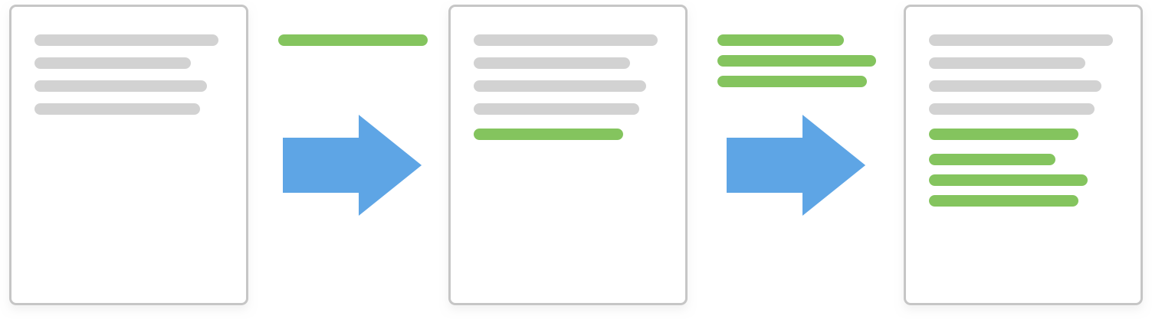
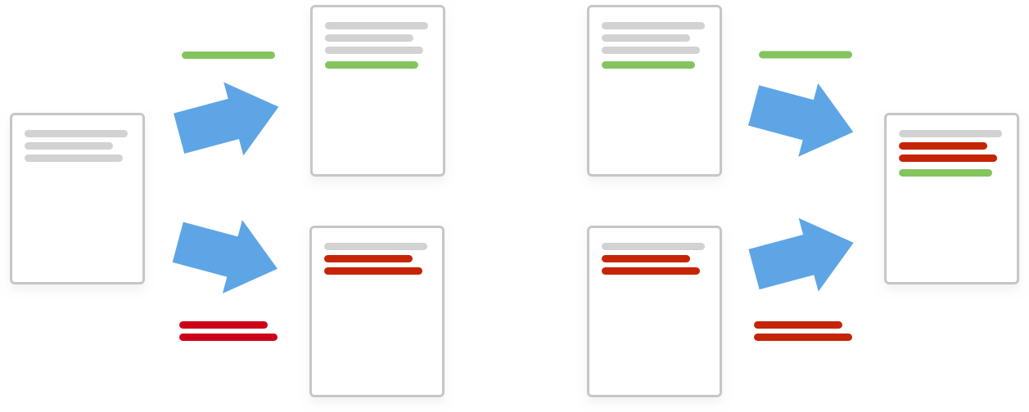
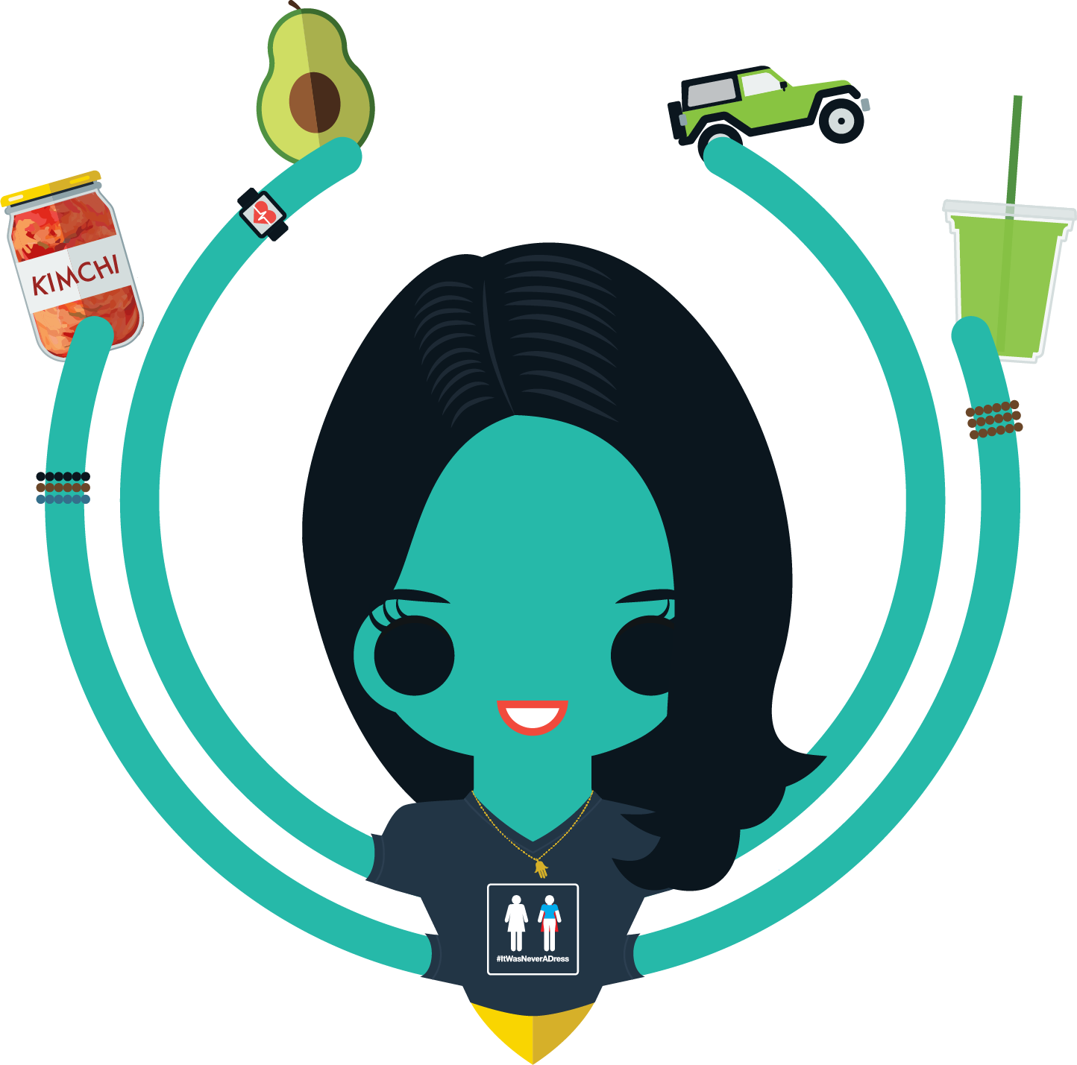
What’s Git?
Git is a version control system that helps you collaborate on projects with others. There are two main features that help you achieve this.
Log changes in a searchable way, instead of renaming a file for each version.
Collaborators can work in parallel and merge their changes automatically, instead of manually comparing the differences between a file

Slide 12
Old-School Git
Some developers use the command line to interact with Git and GitHub by following the best-practice workflow described in the next slides.
First, they might fork someone else's code. This creates their own copy of someone else's project.
Then they would create a branch. The branch is a parallel version of their fork, where they can test changes without editing the master copy.
Key Terms
fork: your own copy of someone else's repository.
branch: a parallel version of the master copy of a repo. Making a branch allows you to edit code without accidentally breaking a working version.

Slide 13
Old-School Git
They stage their changes as they go. When they're happy with them, they commit them.
To add their working version (branch) to the master branch, they open a pull request.
Then, they (or the project owner) will merge the branch into the master branch.
Key Terms
stage: add to a cohesive group/bundle of revisions
commit: a group of revisions you want to officially add to your branch
merge: to officially add the changes from your branch into the master branch (or another branch)

Slide 14
The next few slides will explain the process by which developers might interact with Git using their command line. This is just an explanation – these are not steps to follow!

Slide 15
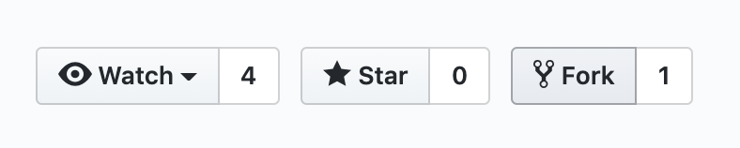
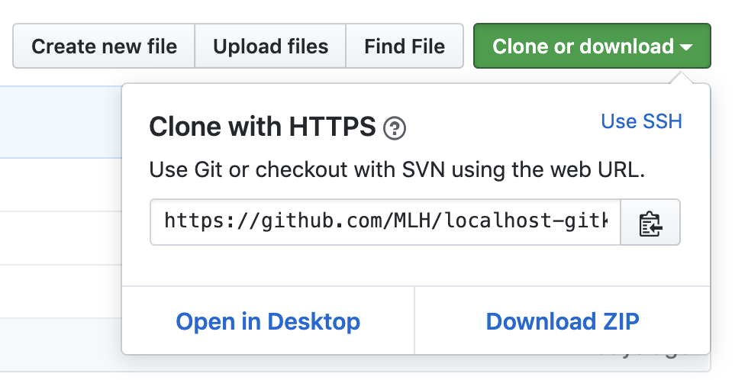
How do they do this?
If a developer is using the command line to complete these steps, their old-school workflow might look something like this:
Go to GitHub to find the project they want to work with and click fork.
Go to their own GitHub profile to see their fork of the repo, and copy the clone URL.

Slide 16
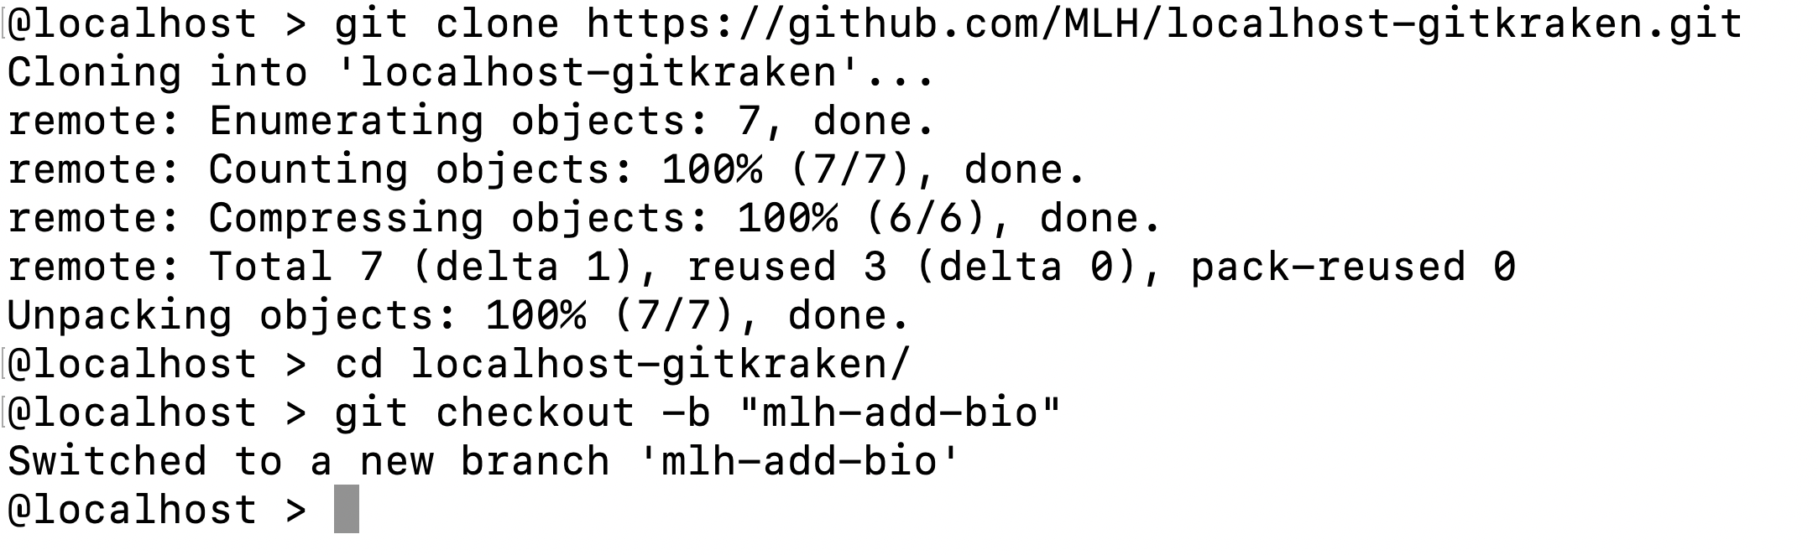
How do they do this?
Open their terminal and enter these commands to clone the repo and create a branch.

Slide 17
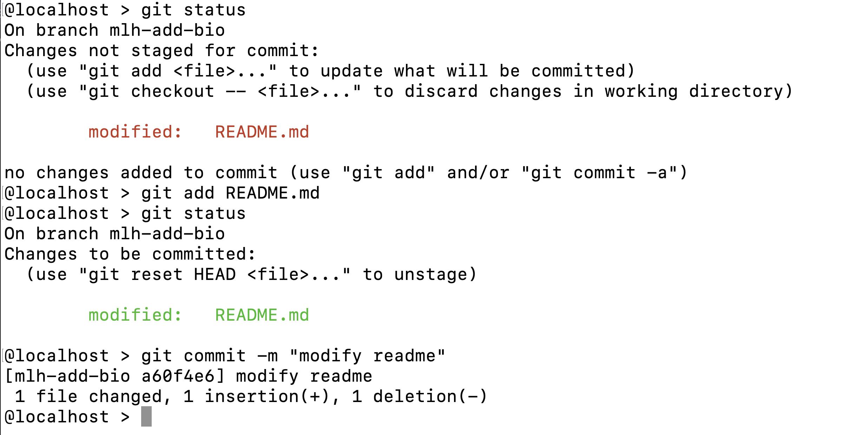
How do they do this?
After making changes using their text editor, they would enter these commands to stage their changes and commit them.

Slide 18
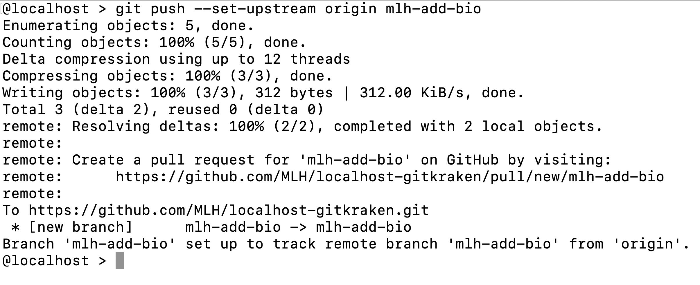
How do they do this?
Then they would push the changes up to the repository on GitHub.
Then they might go to GitHub to review and merge the pull request.

Slide 19
+
Get Crackin' with Git using GitKraken!
Why GitKraken?
Git is powerful, but memorizing commands is time-consuming and how Git works can be tricky to visualize.
GitKraken provides a visual interface enabling the same workflow with only a few clicks.

Slide 20
Now that you have a basic introduction to Git, let's have GitHub and GitKraken do the hard work for us!

Slide 21
+
Get Crackin' with Git using GitKraken!
Table of Contents
1. Intro to Git and GitHub
2. Set up GitKraken
3. Collaborate!
4. Review and Quiz
5. Wrap Up and Next Steps

Slide 22
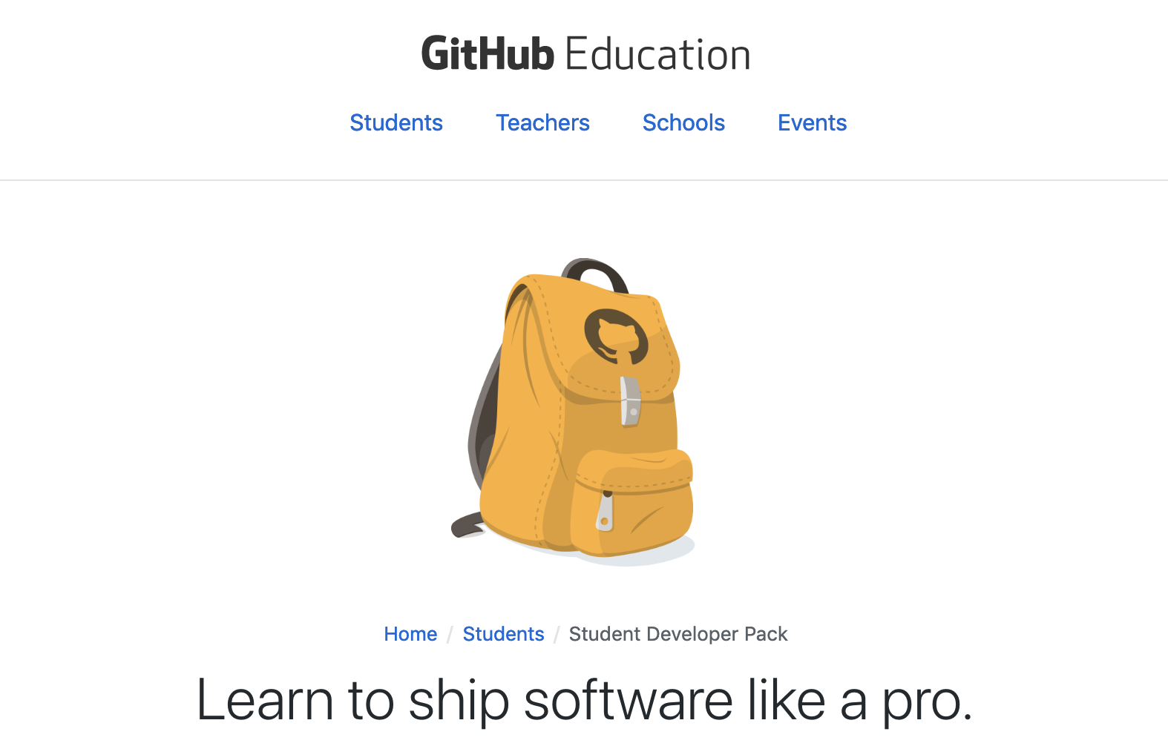
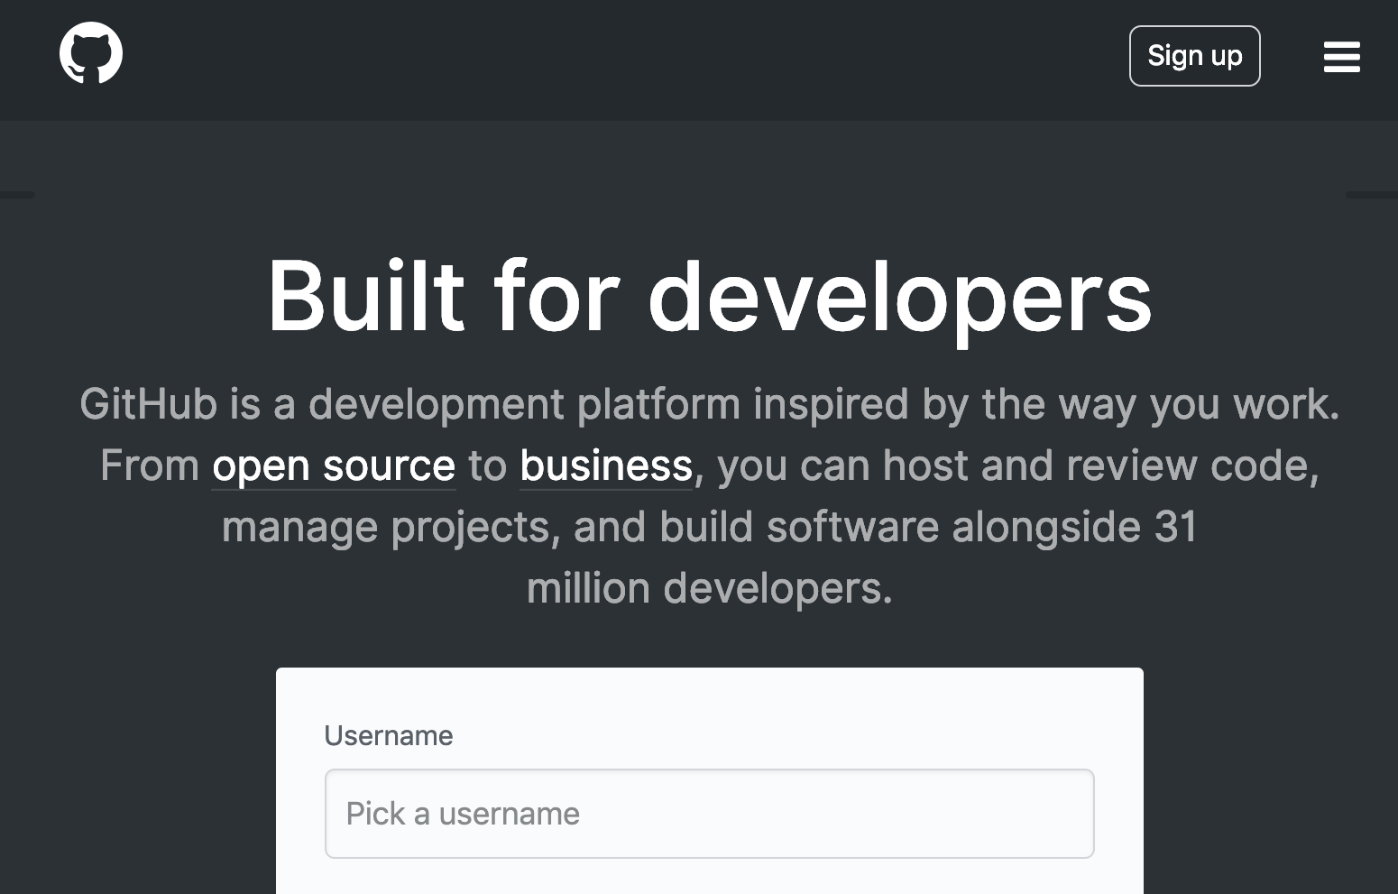
Make a GitHub Account
Visit the URL on the left if you're a student or the right if you are not.
Follow the instructions on GitHub.com to make your account!
http://mlhlocal.host/github-edu
http://mlhlocal.host/github-signup

Slide 23
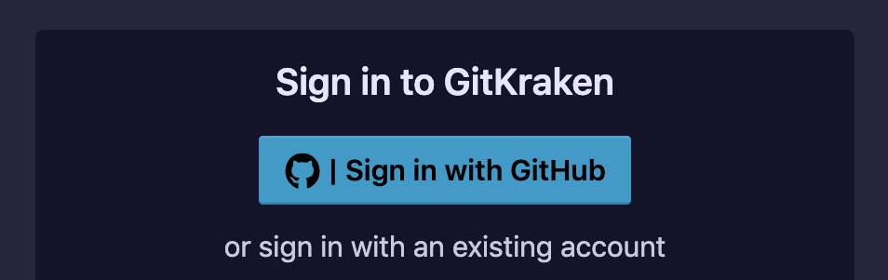
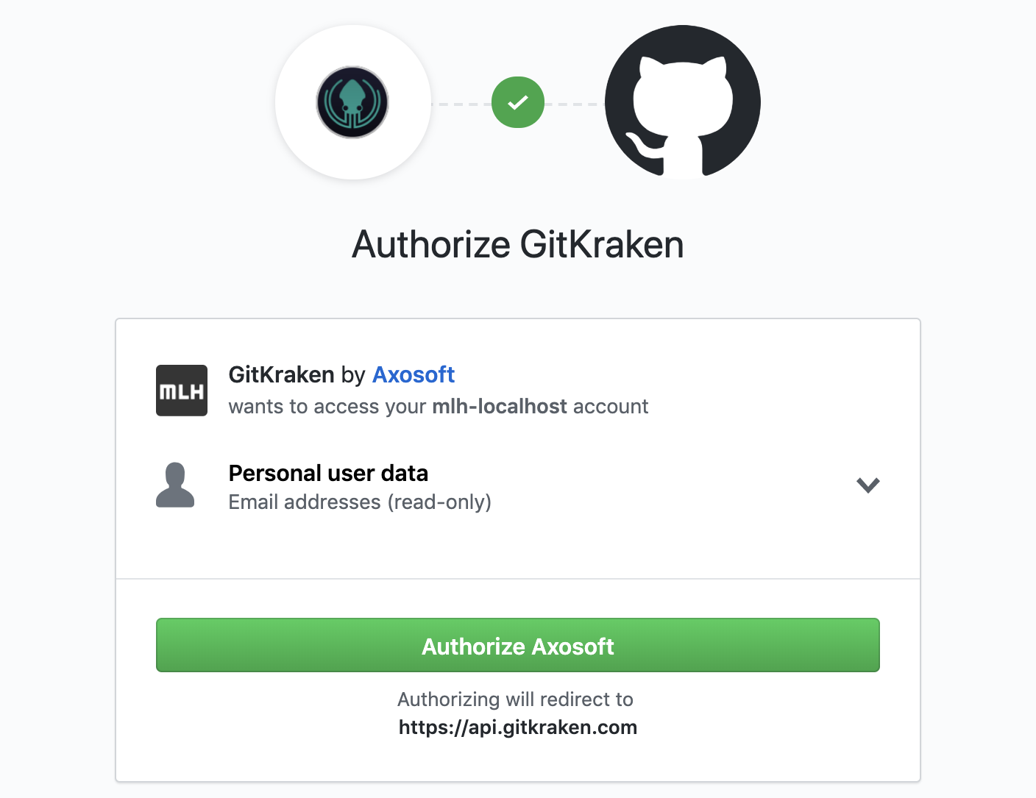
Sign up for GitKraken
Follow the instructions below to create a GitKraken account.
[Your GitKraken Referral URL]
Once you have created a GitHub account, visit the URL above.
Select Sign in with GitHub.
Then select Authorize Axosoft (the company that makes GitKraken!)
Notes:
Replace the text in the text field with

Slide 24
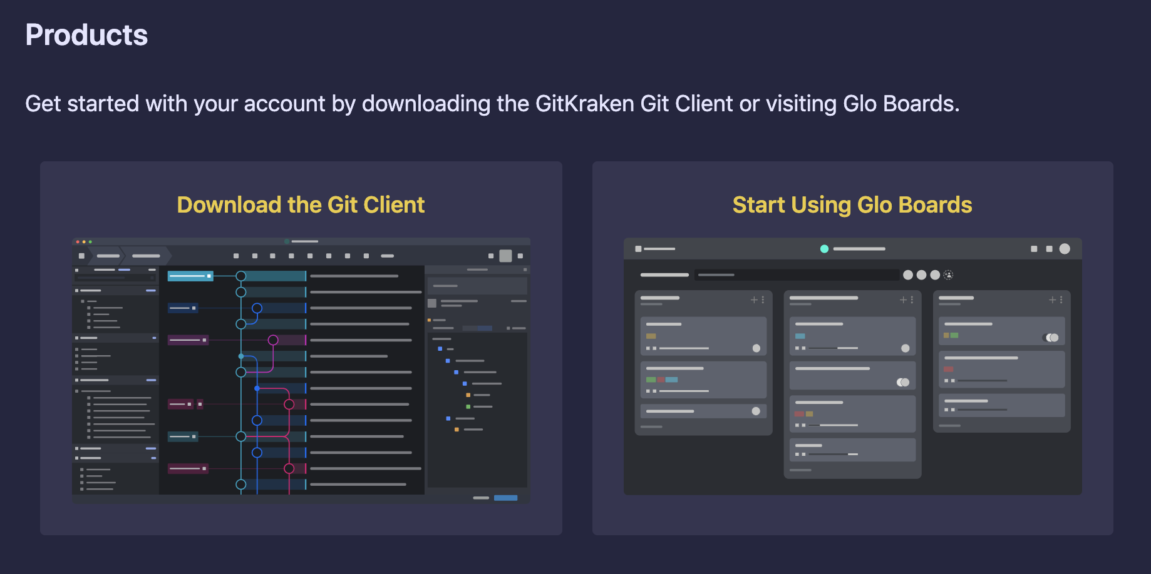
Sign up for GitKraken
Select Download Now.

Slide 25
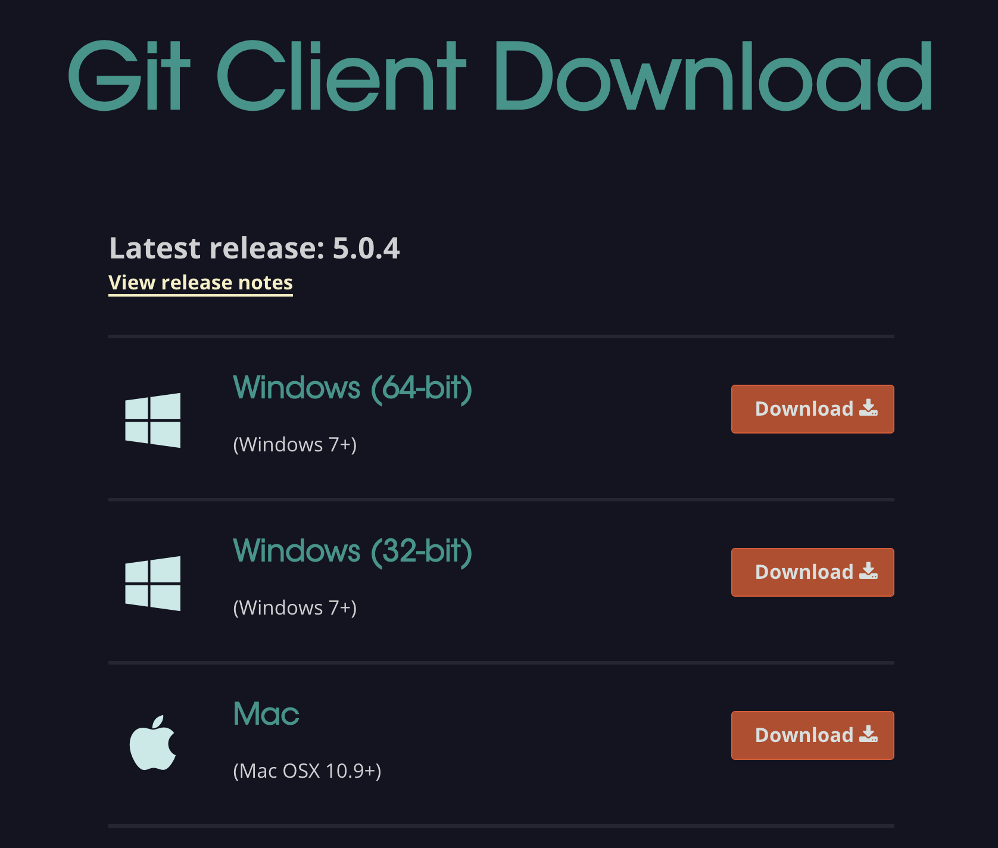
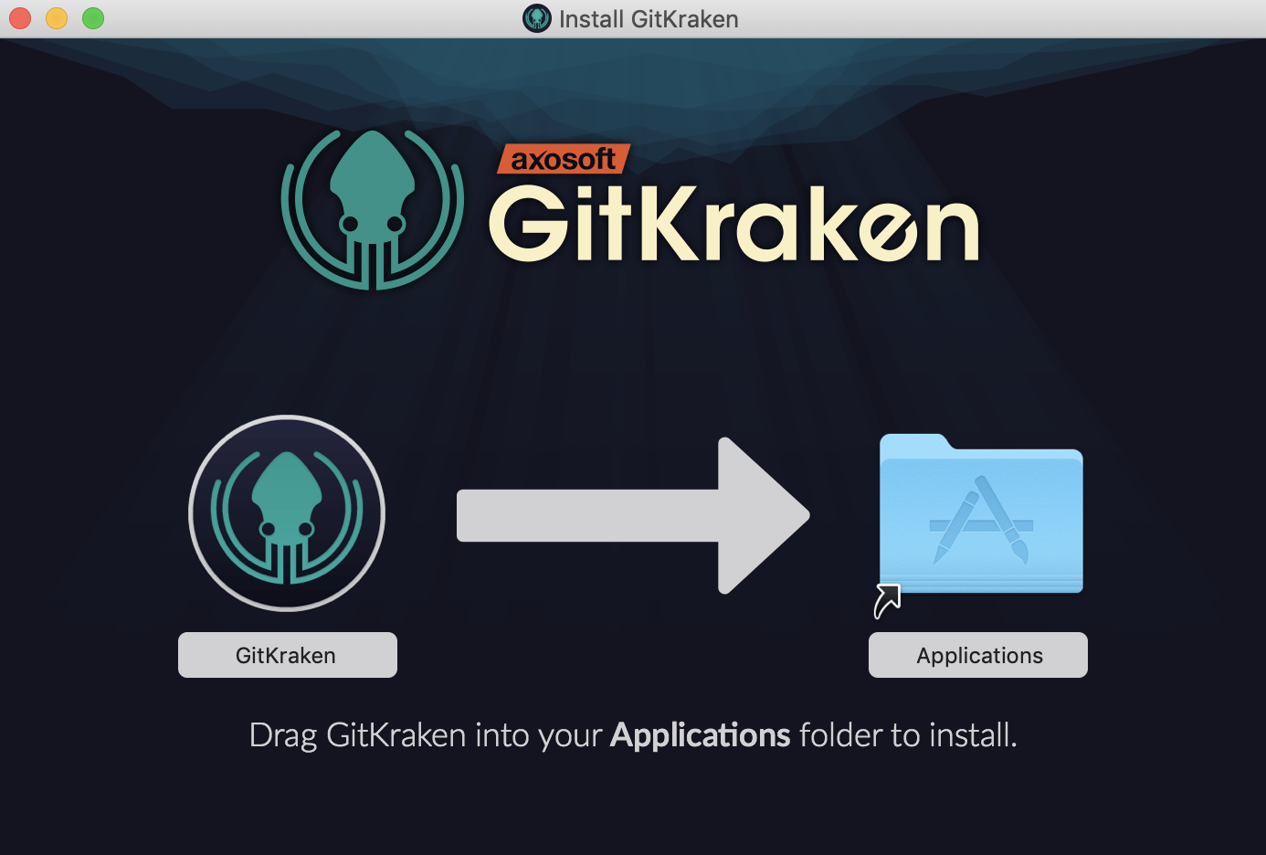
Download the Git Client
6. Download the Git Client for your operating system.
7. Then, follow the installation instructions for your operating system.

Slide 26
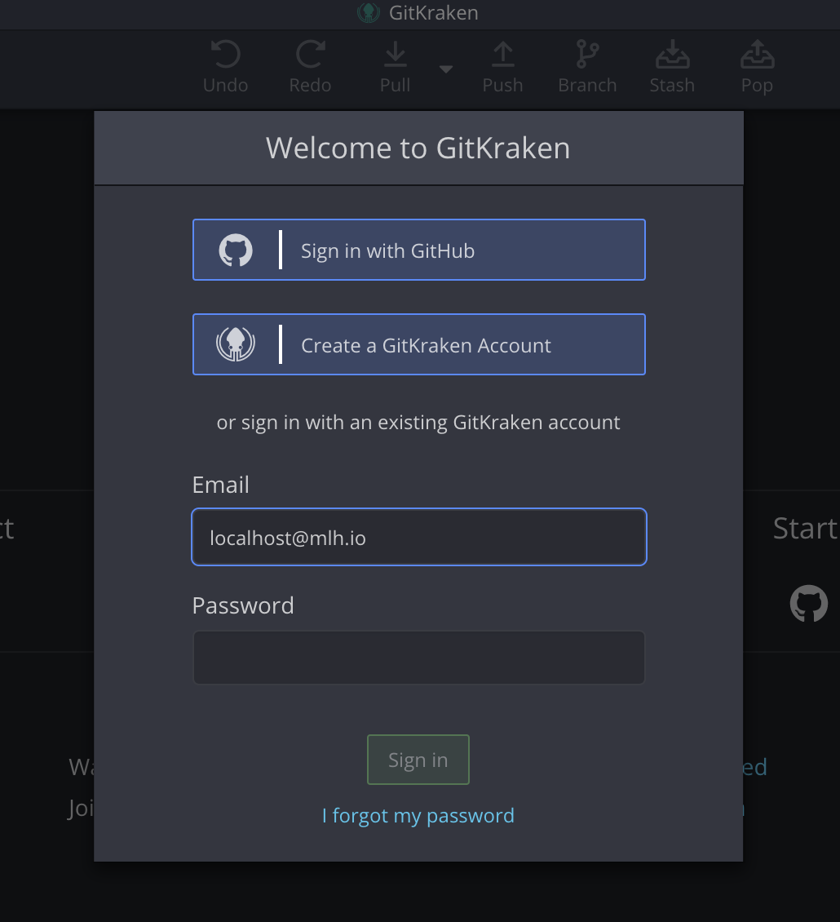
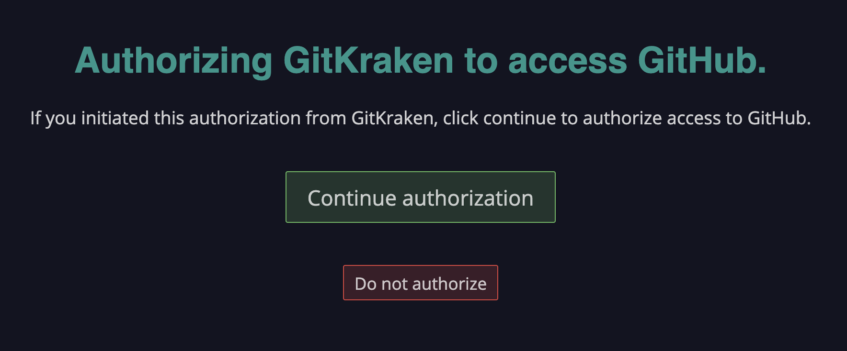
Download the Git Client
8. Select Sign in with GitHub as before, which will open a web browser.
9. Then, select Continue authorization.

Slide 27
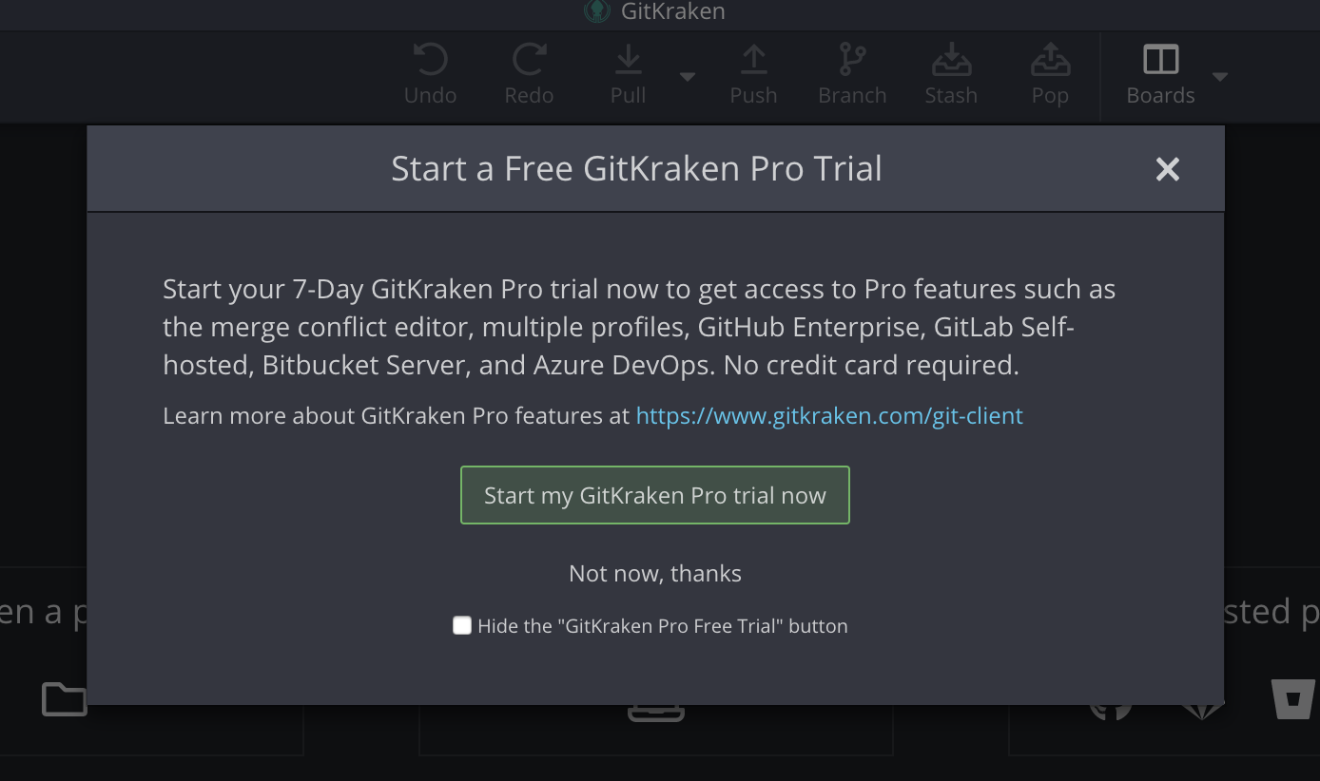
Download the Git Client
10. If you see this modal, select Start my GitKraken Pro trial now. If you don't see this, your GitKraken account was automatically updated to Pro when you made your GitHub Edu account!

Slide 28
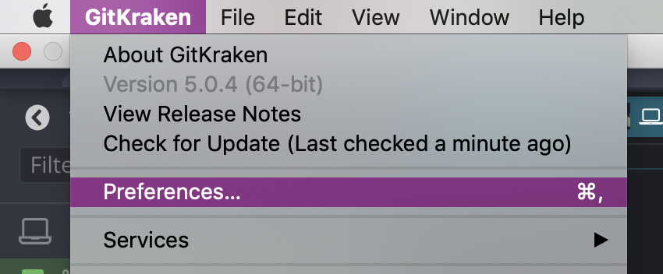
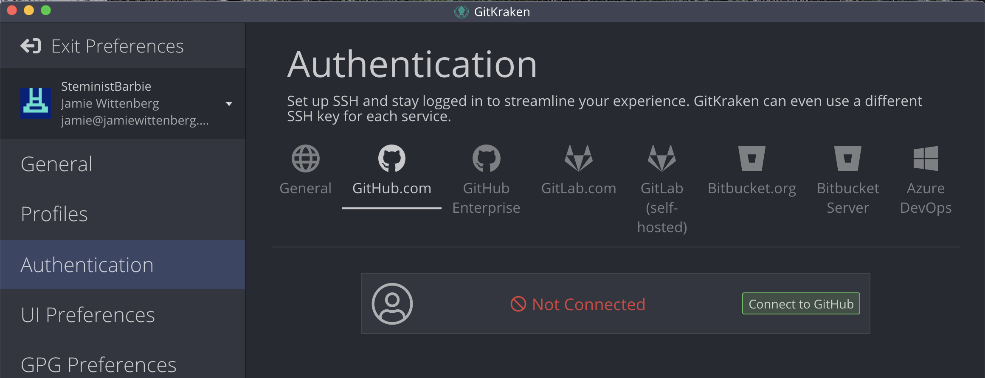
Integrate GitHub
11. To make sure that GitKraken is authorized to work with your GitHub account, open your Preferences.
12. Select Authentication, then GitHub.com.
13. If your GitHub account is not already connected, select Connect to GitHub.

Slide 29
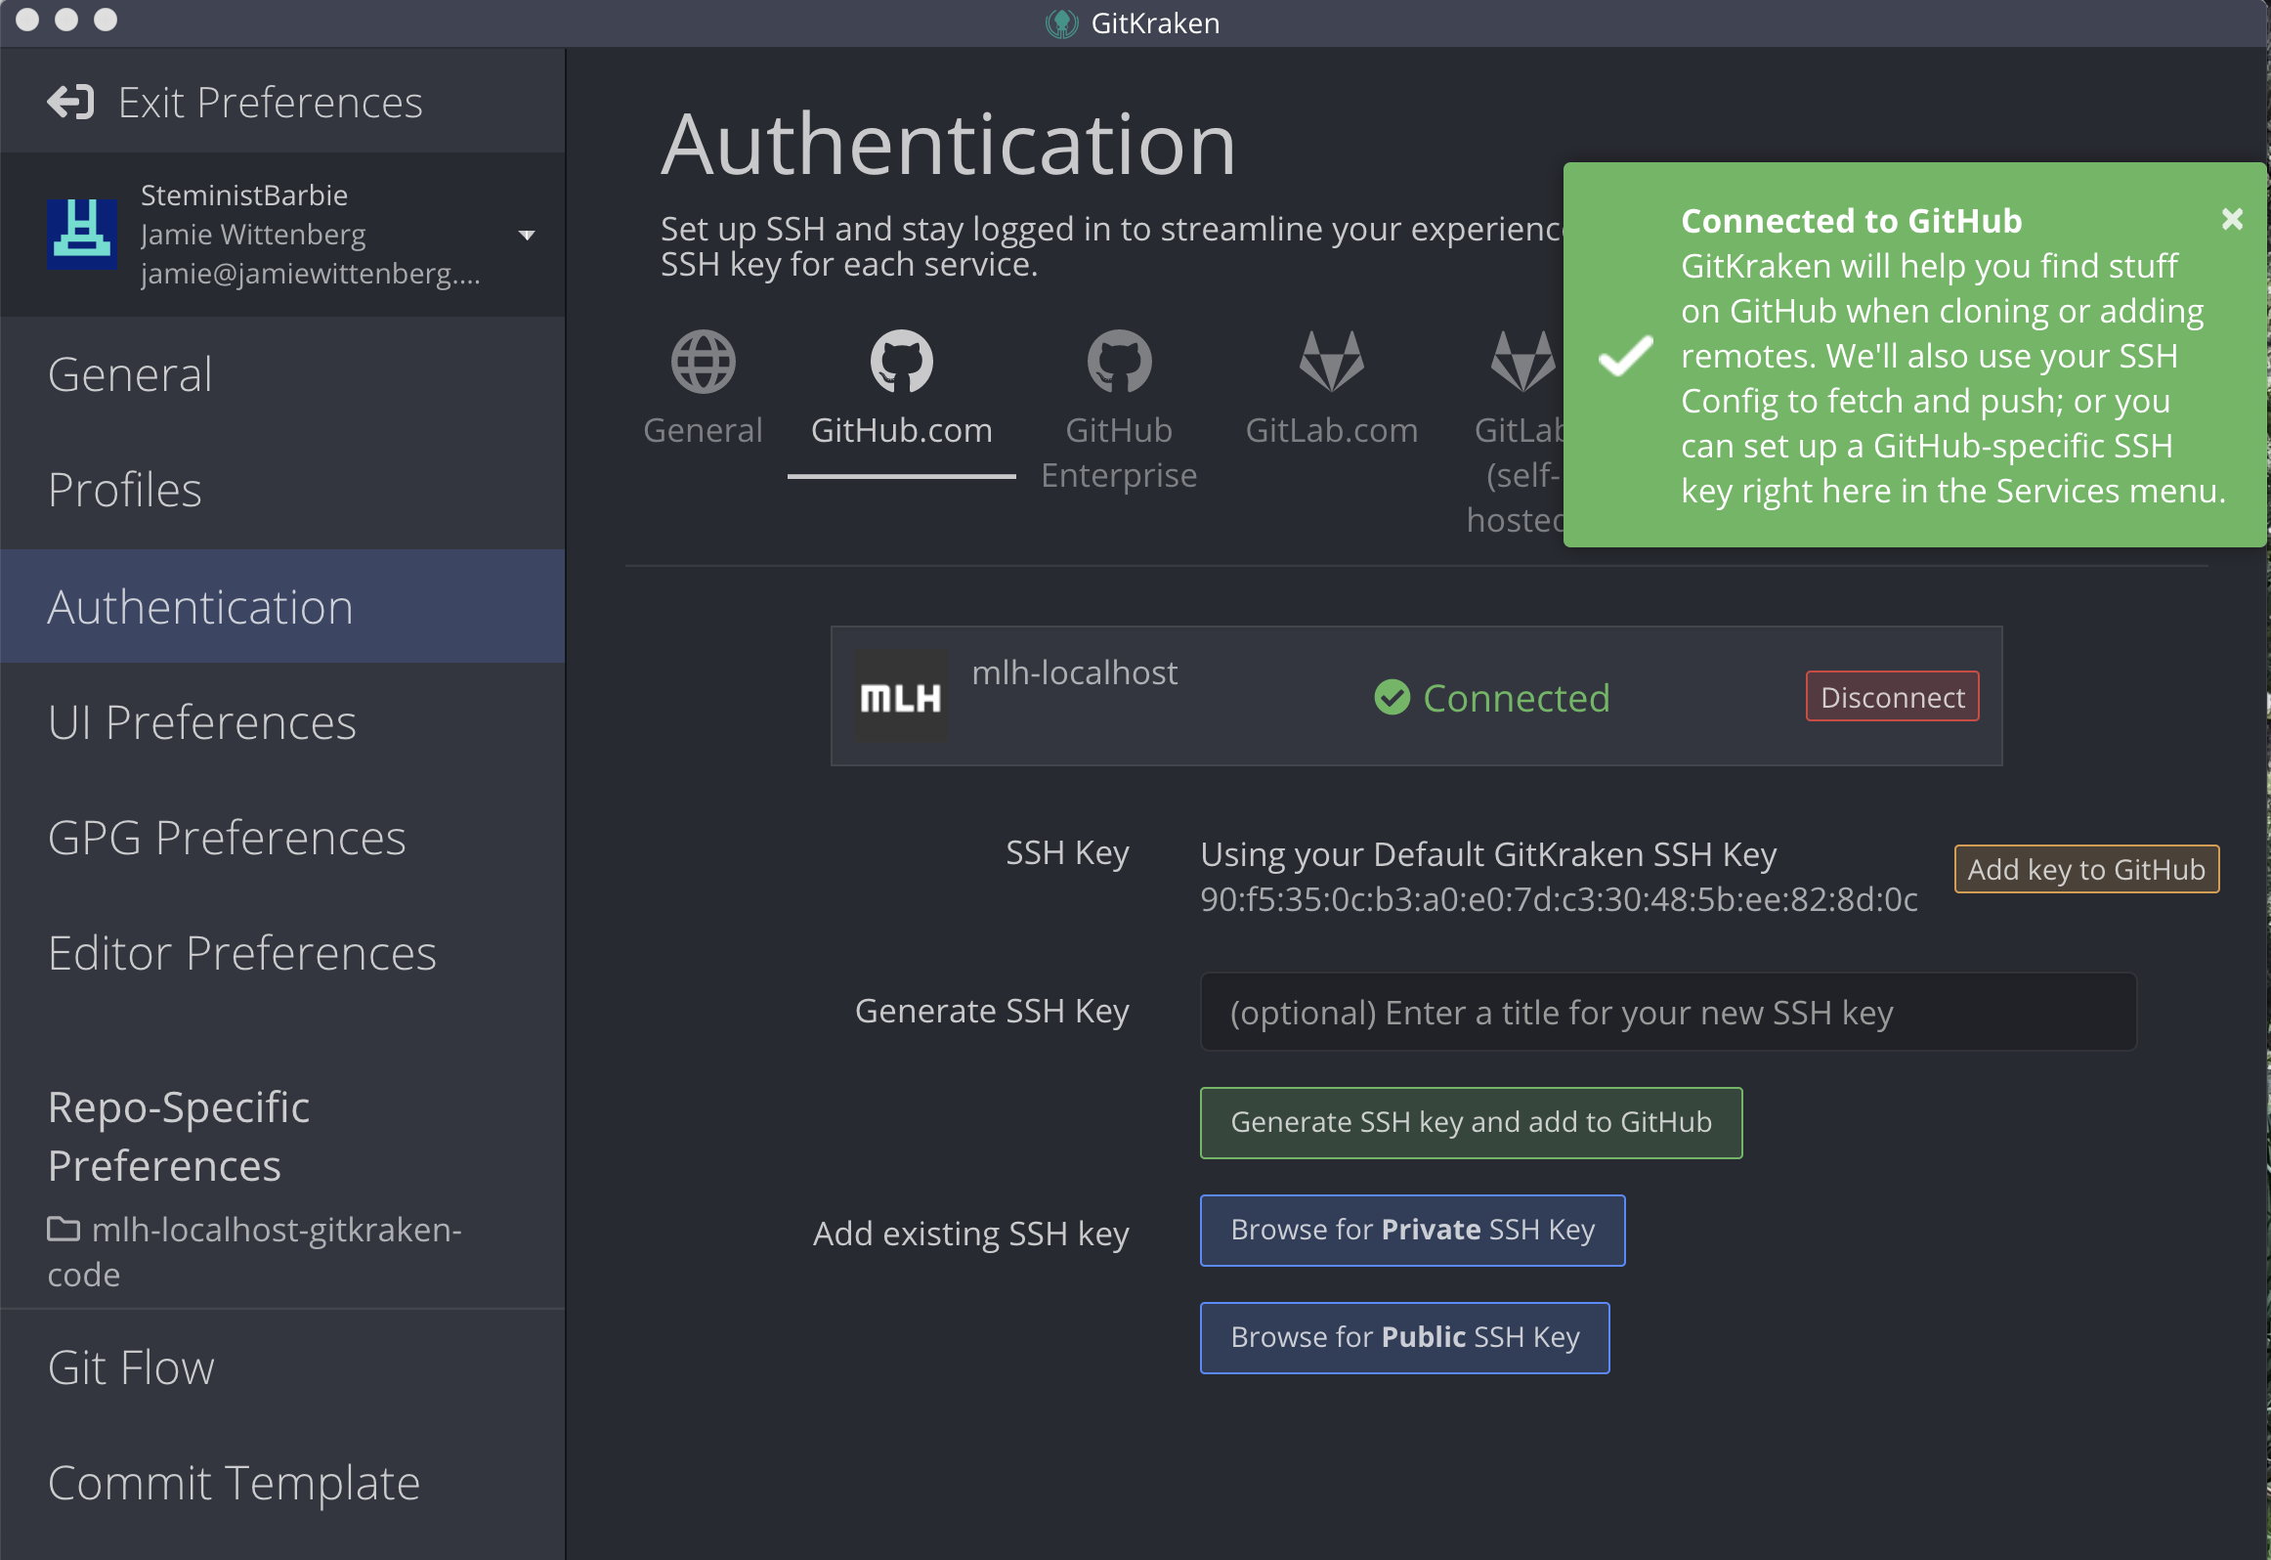
Integrate GitHub
14. When you see this screen, select Exit Preferences.

Slide 30
Now that you're all set up, let's form a team!

Slide 31
+
Get Crackin' with Git using GitKraken!
Table of Contents
1. Intro to Git and GitHub
2. Set up GitKraken
3. Collaborate!
4. Review and Quiz
5. Wrap Up and Next Steps

Slide 32
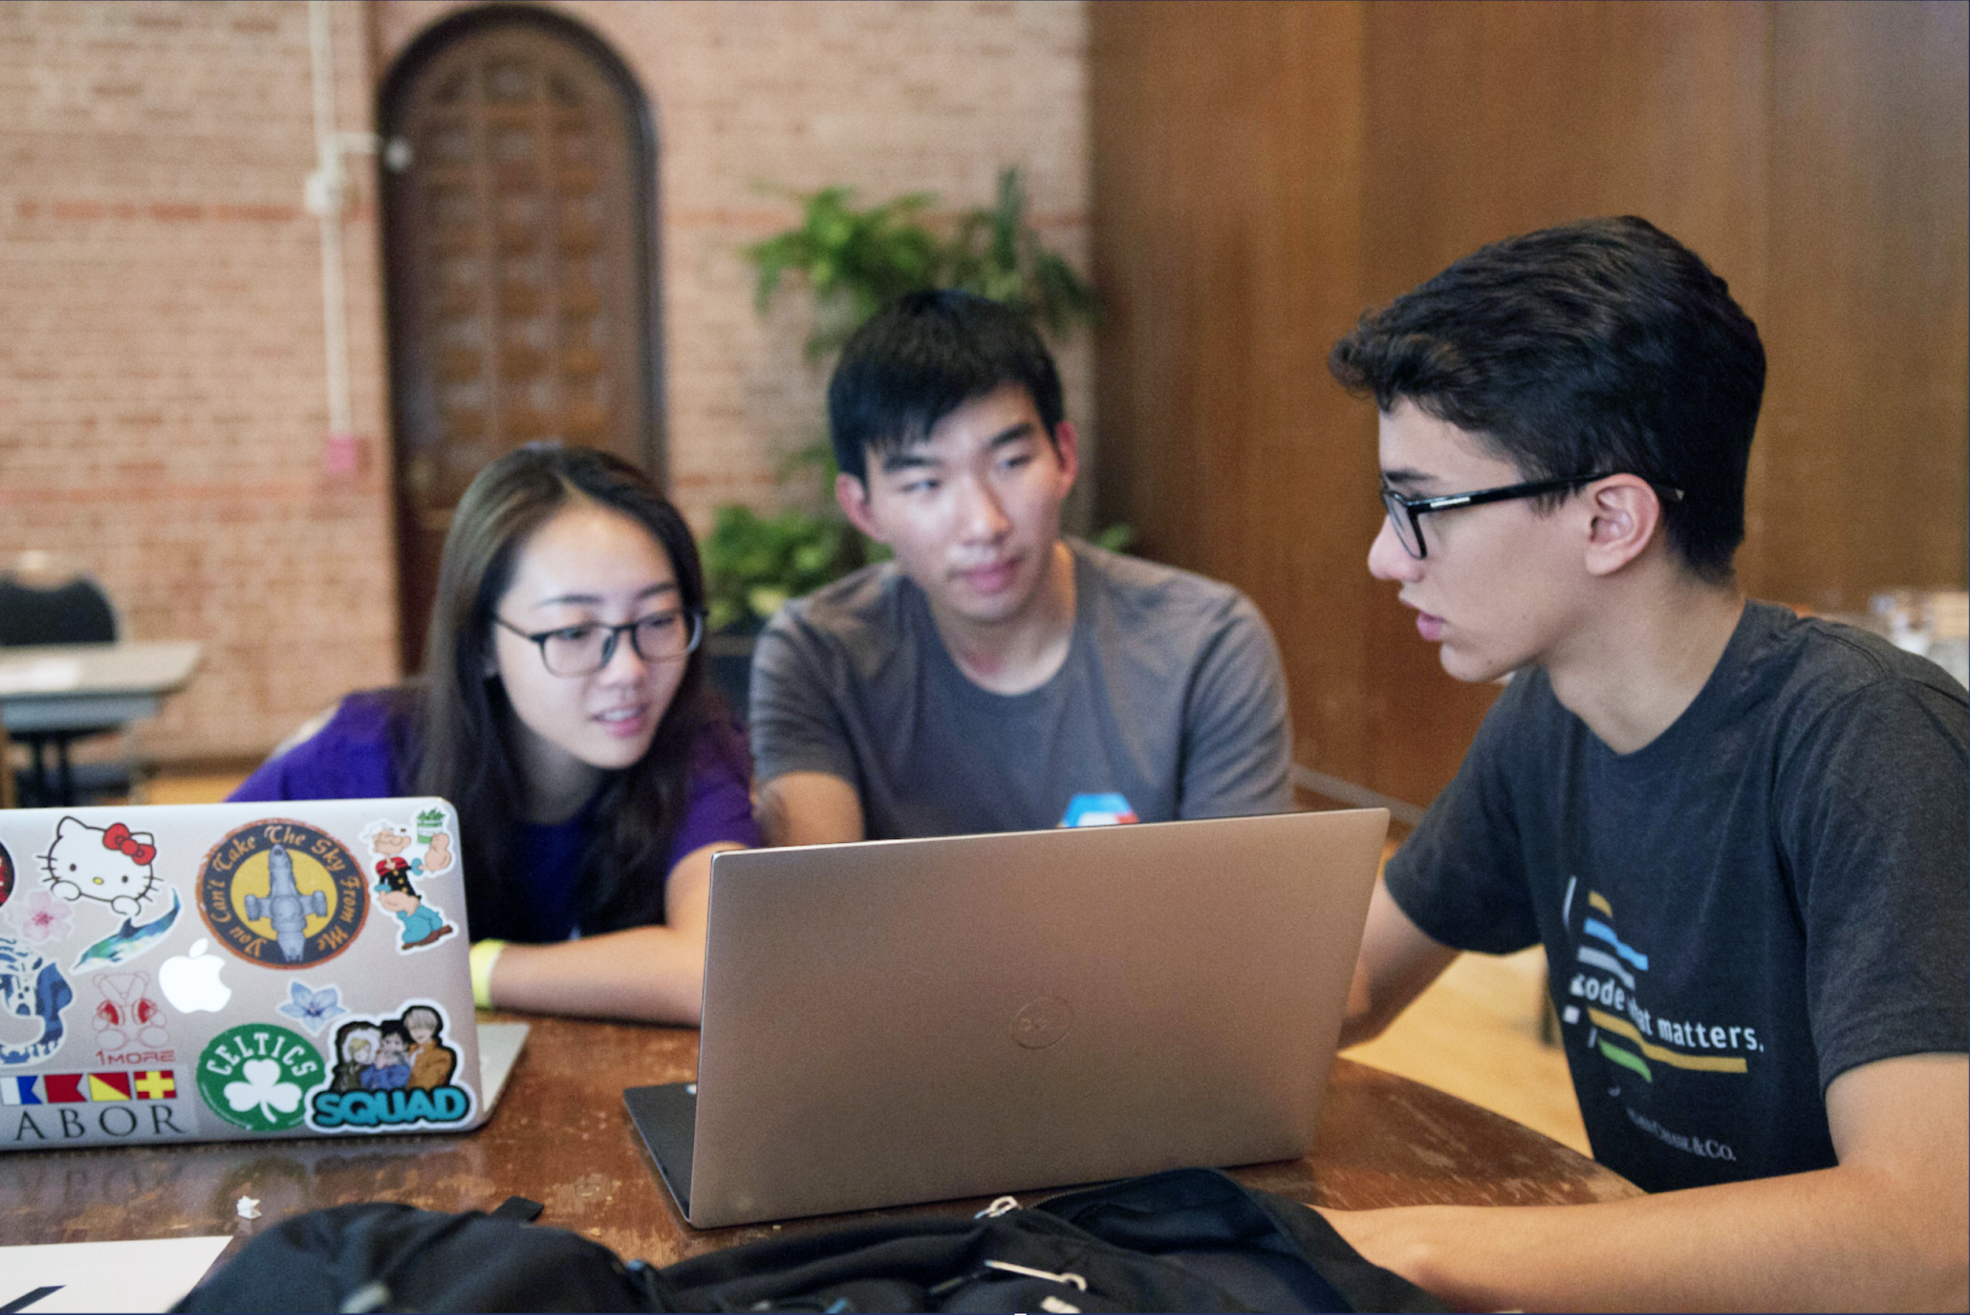
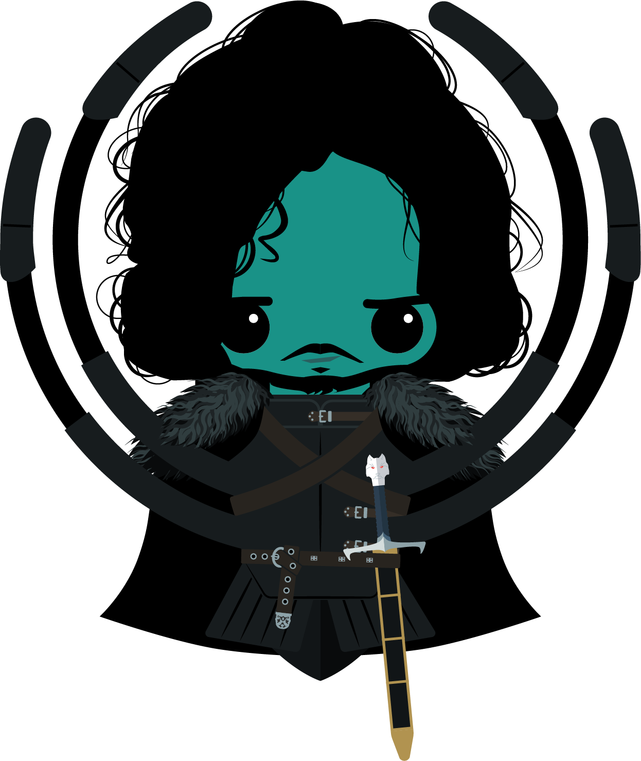
Team Formation!
In order to really learn how to collaborate, you have to work with a team! Teams of 3 – 5 people will work well for this workshop. Group with people around you.

Slide 33
Now that you have your team, let's get the code.

Slide 34
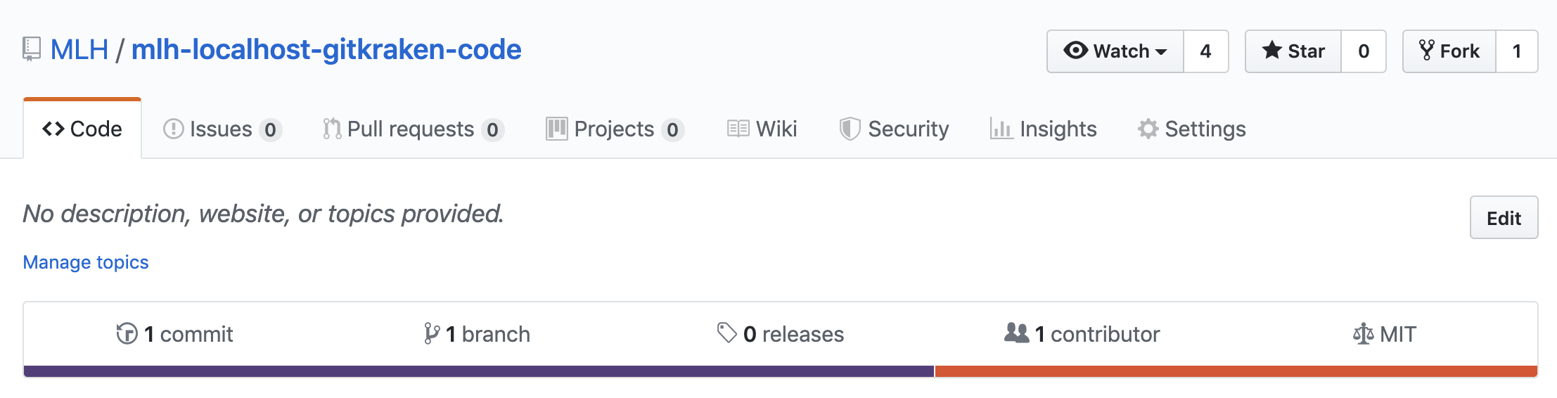
Get the Source Code
In the next few steps, your team will create a shared repo for your team webpage! Follow these instructions very carefully.
http://mlhlocal.host/gitkraken-code
Key Term
fork: create a copy of a Git repository
Pick one of your team members to navigate to the URL above.
This team member will fork the repository.

Slide 35
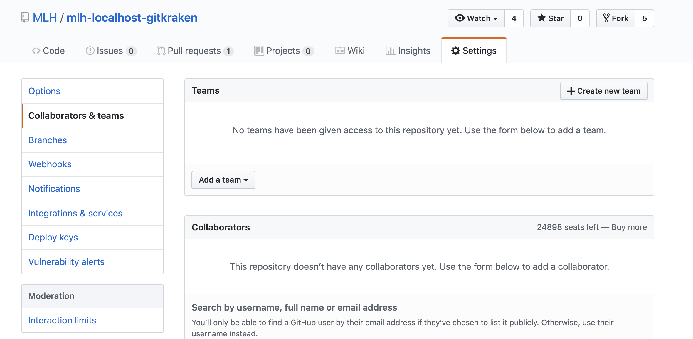
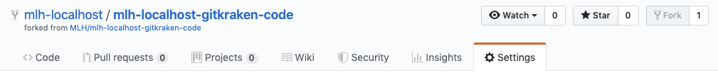
Get the Source Code
The same team member needs to add the other team members as collaborators on the repository. Click Settings -> Collaborators at the top of your fork of the repo.
Add each person's GitHub username under Collaborators.

Slide 36
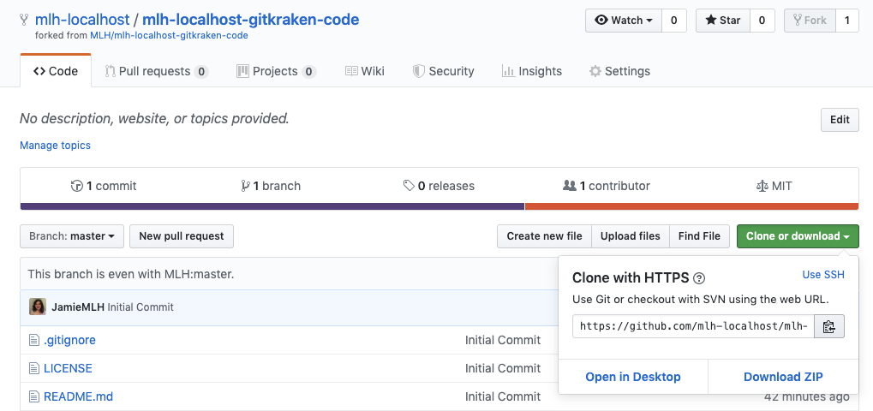
Get the Source Code
Then, each person, including the first, should copy their clone URL.

Slide 37
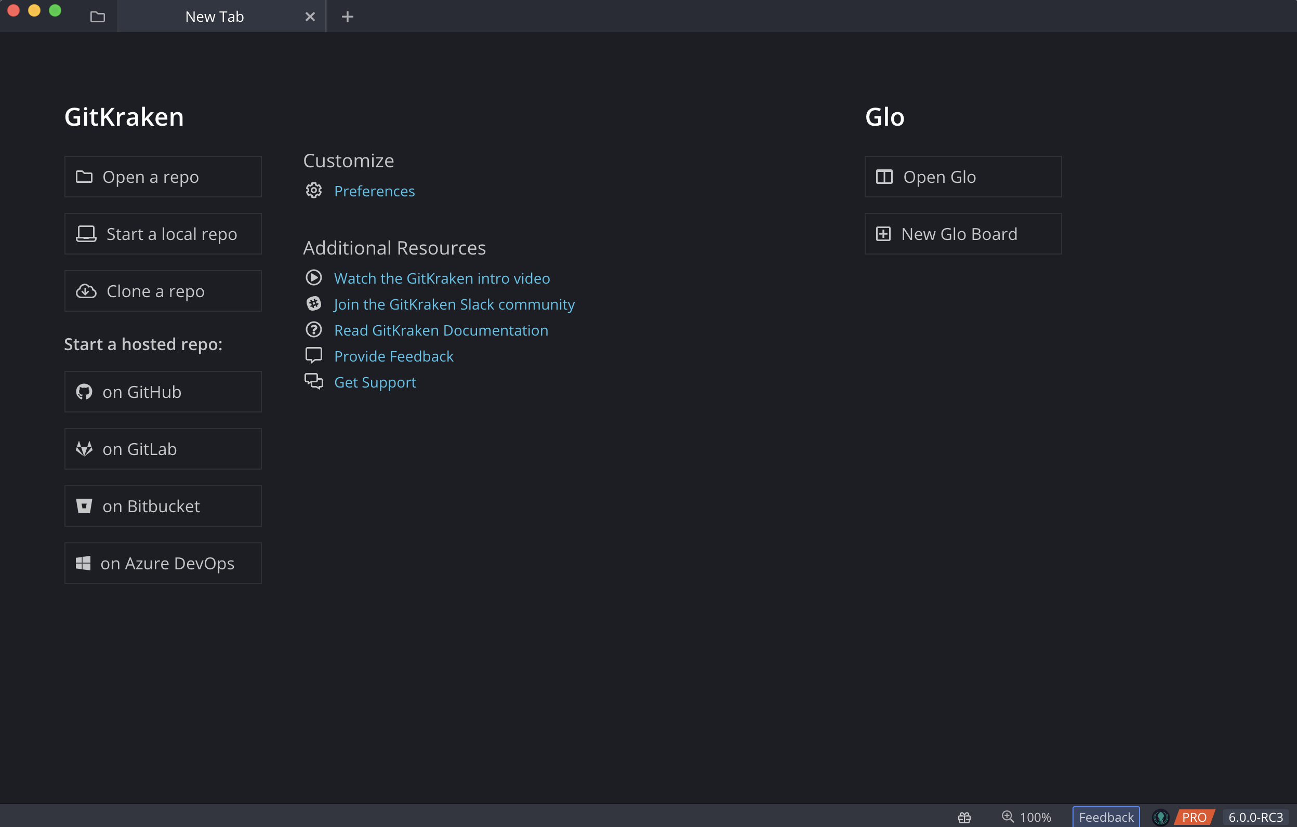
Get the Source Code
Each team member should return to GitKraken.
Select Clone a repo.

Slide 38
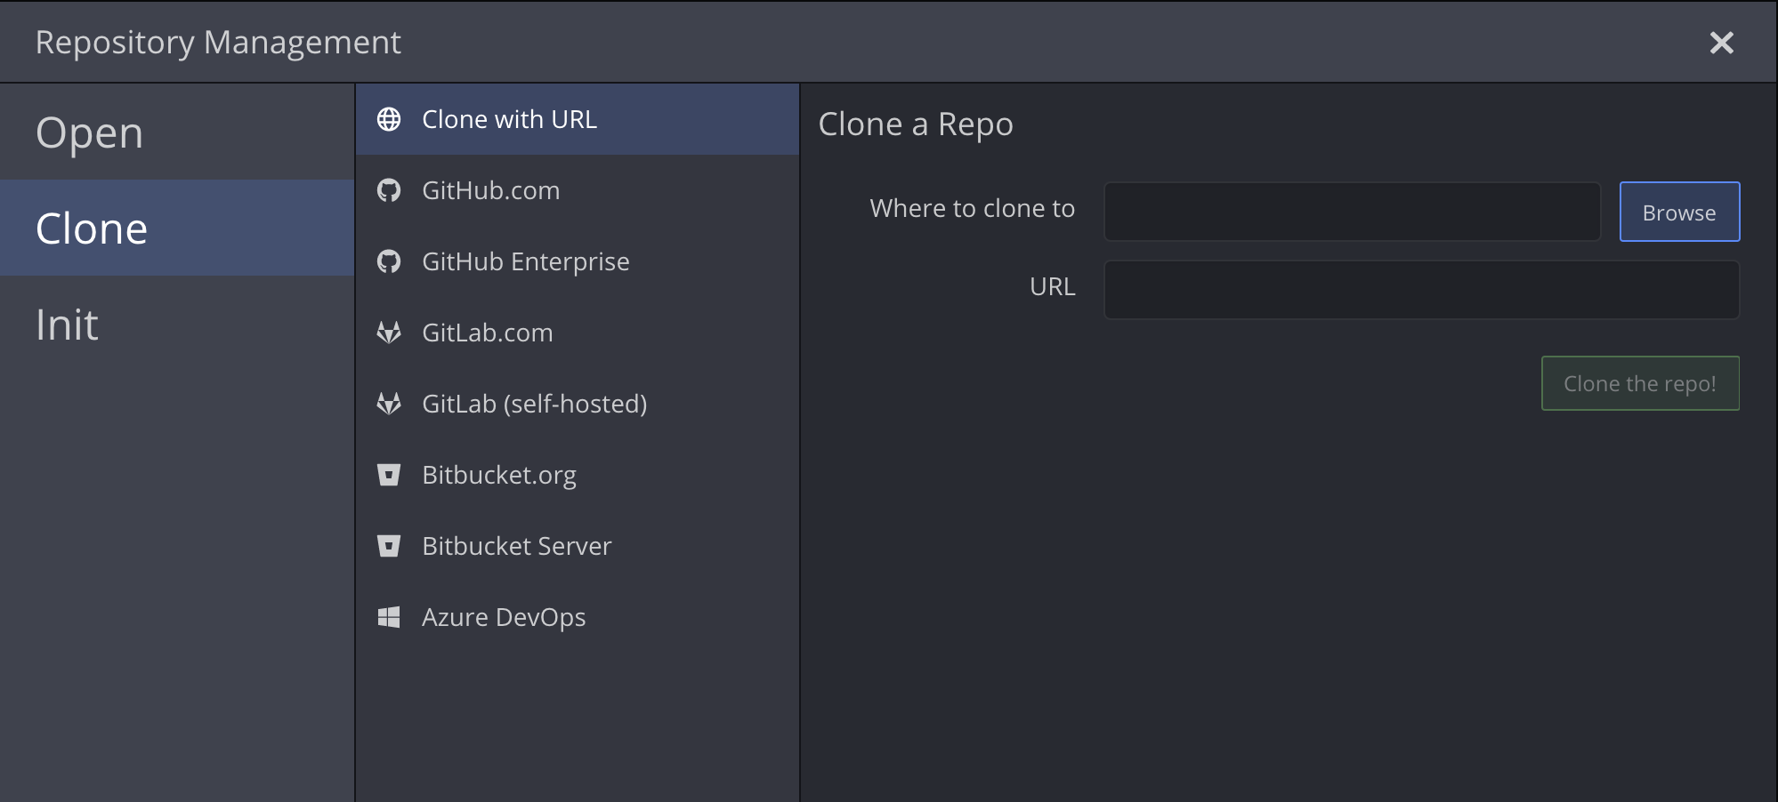
Get the Source Code
Browse for where you'd like the project to be stored on your computer.
Paste the clone URL you copied into the URL field.
Click Clone the repo!

Slide 39
Get the Source Code
At the top of the screen, a bar should appear. Select Open Now.

Slide 40
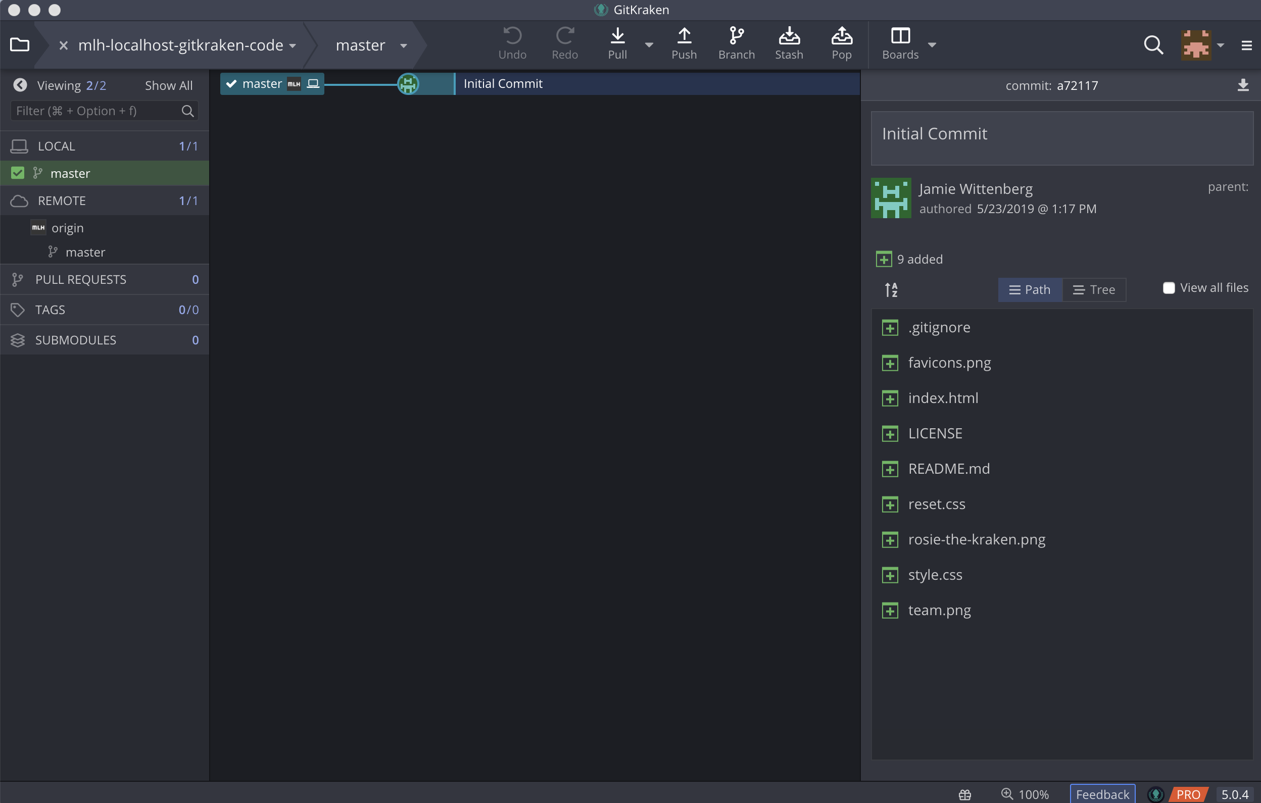
Let's Explore GitKraken!
There are SO MANY awesome features in GitKraken, all of which correspond to parts of the Git workflow. Let's identify a few of them before getting to work.

Slide 41

Let's Explore GitKraken!
In the upper left hand corner, you can see the name of the project you're working on (mlh-localhost-gitkraken-code) and the name of the branch you have checked out (master).
Key Term
branch: a parallel copy of a repository, inside the repository (whereas a fork is a copy of a repository outside of the repo).

Slide 42
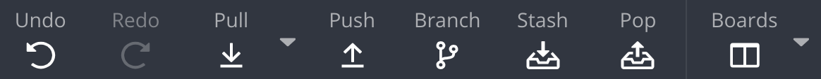
Let's Explore GitKraken!
At the top of GitKraken, in the center, you can see a selection of useful options!
pull – to bring changes from the remote down to your local environment. You would use this option if someone else has made changes to the project that you also want in your copy of the project.
push – to add your local changes to the remote.
Key Term
remote: the repository on GitHub (or any other version control platform) that your local repository is associated with

Slide 43
Let's Explore GitKraken!
At the top of GitKraken, in the center, you can see a selection of useful options!
branch – to create a copy of the project inside of the project itself. This allows you to make changes and test them out, without finalizing them until you're satisfied.
stash – when you have changes that you aren't ready to commit, but you want to switch to another branch, you can stash your changes.
pop – to delete your stash from the stack

Slide 44
Let's Explore GitKraken!
On the left side of the window, you can see branches and pull requests.
LOCAL – this shows the branches you have in your local environment (on the computer you're using). If you create a branch in GitKraken (or through the command line) that branch will appear here. You can then push it to the remove.
REMOTE – this shows the branches in the remote repository (the hosted repository, like on GitHub). These branches might not always be the same.
PULL REQUESTS – this lists any open pull requests against your repository.

Slide 45
There are a lot of steps coming up! Let's create a team Glo Board to keep track of our progress.

Slide 46
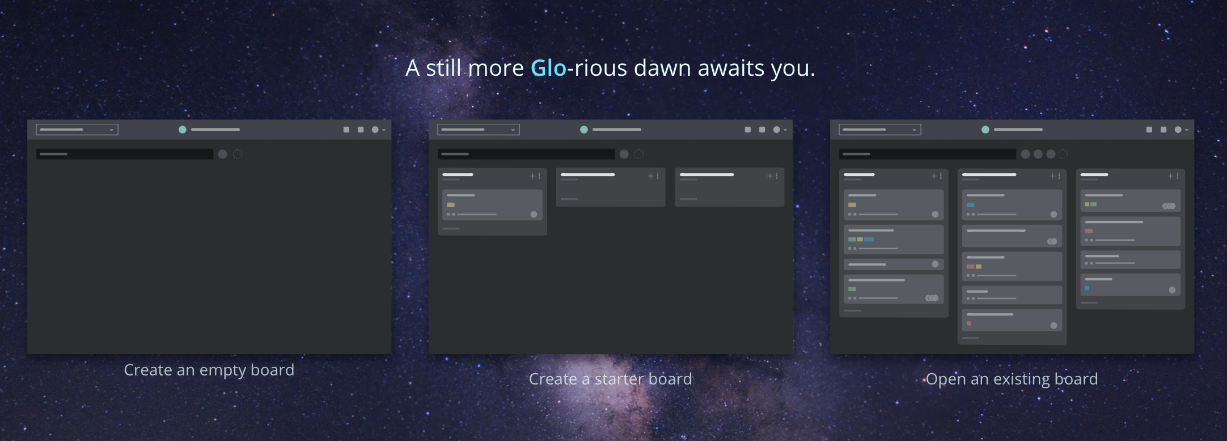
Access Glo Boards
Only one person on your team should make a board. They will invite everyone else to the board. In the toolbar, select Boards. The screen below will open.
Select Create a starter board.

Slide 47
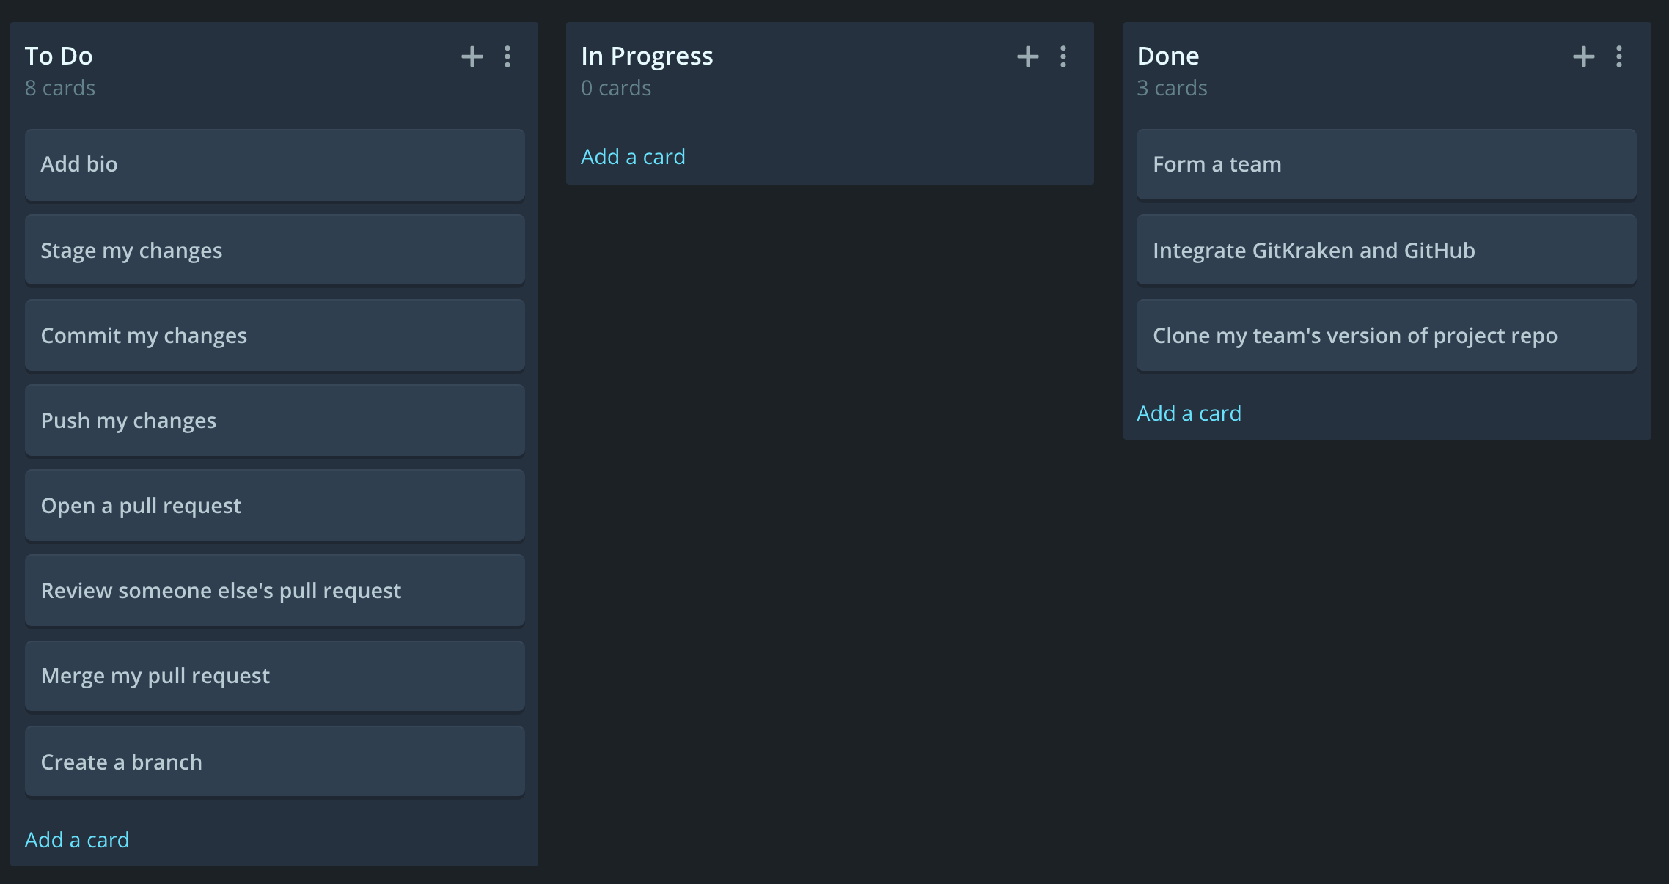
Access Glo Boards
Click Starter Board to rename the board to something descriptive, like GitKraken workshop, by clicking on the title.
Add these cards to your To Do list by clicking + or Add a card
Move any steps that you have completed to Done, and any steps you're currently working on to In Progress by dragging and dropping.

Slide 48
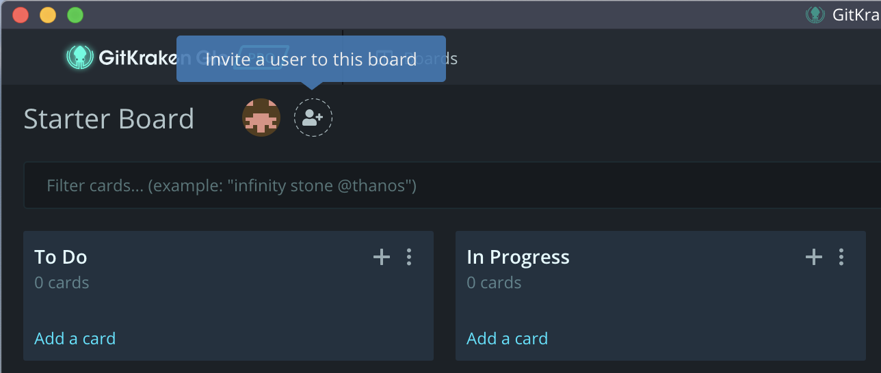
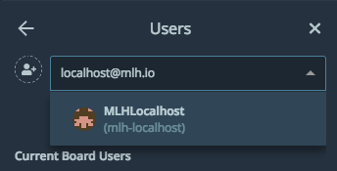
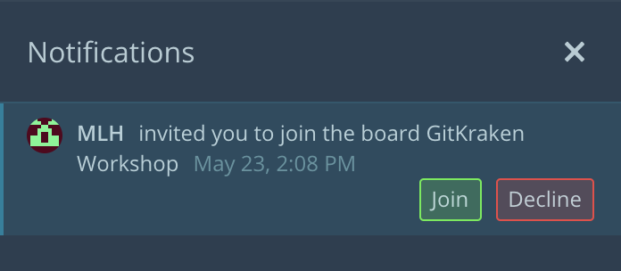
Access Glo Boards
Next to the name of the board, you can see who is on the board. Select the icon to add collaborators.
Everyone else will get a notification about the invitation to join the board.

Slide 49
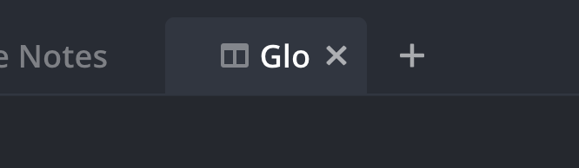
Access Glo Boards
Click the Glo tab in GitKraken to refer back to your board as you complete steps!

Slide 50
Now that everyone's teams are in place, we're going to clone the source code repo using GitKraken!

Slide 51
+
Get Crackin' with Git using GitKraken!
Table of Contents
1. Intro to Git and GitHub
2. Set up GitKraken
3. Collaborate!
4. Review and Quiz
5. Wrap Up and Next Steps

Slide 52
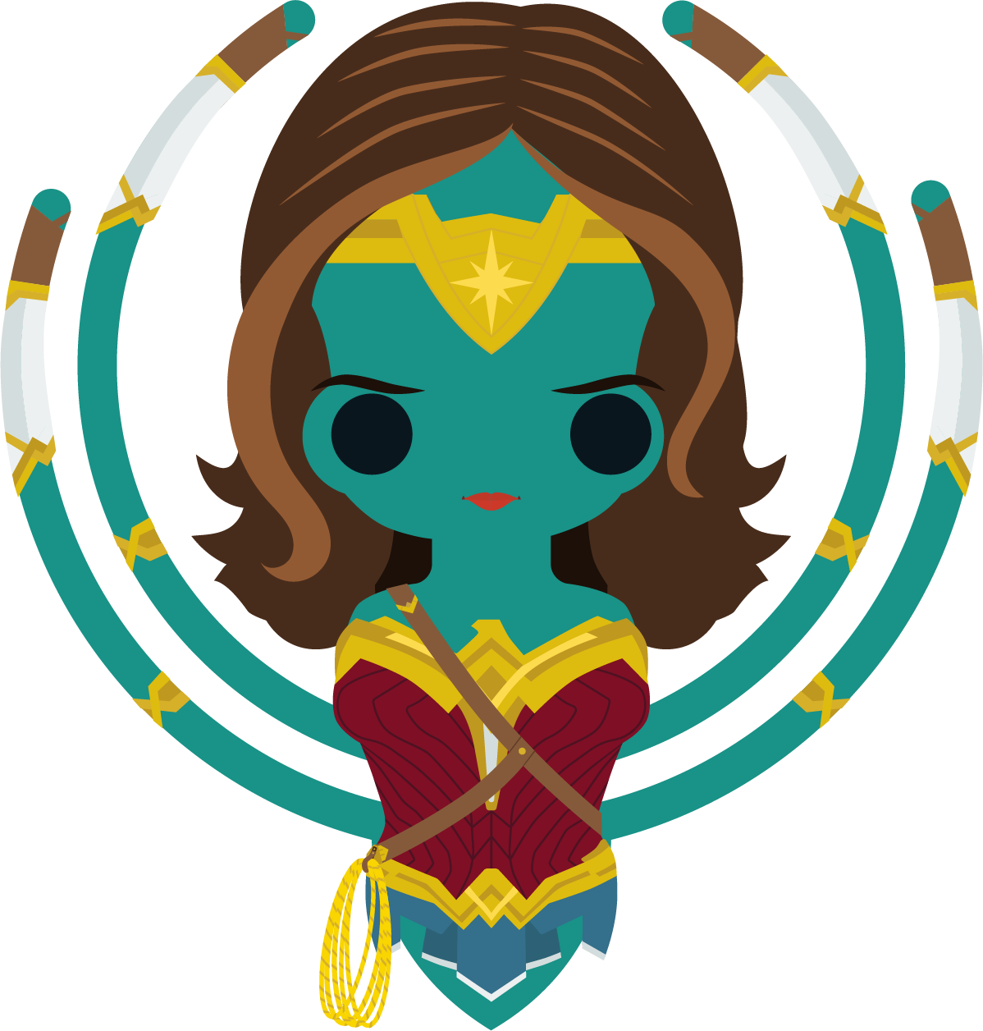
Collaborate
Let's put all these features to use! As you complete each of these steps, you'll switch back and forth between the Git Client and Glo Boards to mark off steps.

Slide 53
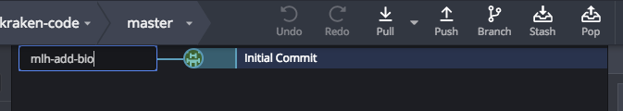
Create Your Own Branch
At the top of GitKraken, click Branch.
Name your branch and hit Enter or Return. You will be switched to your new branch!

Slide 54
Open the Project
On the right side of GitKraken, select View all files.
Then, click index.html to open it in the GitKraken editor.

Slide 55
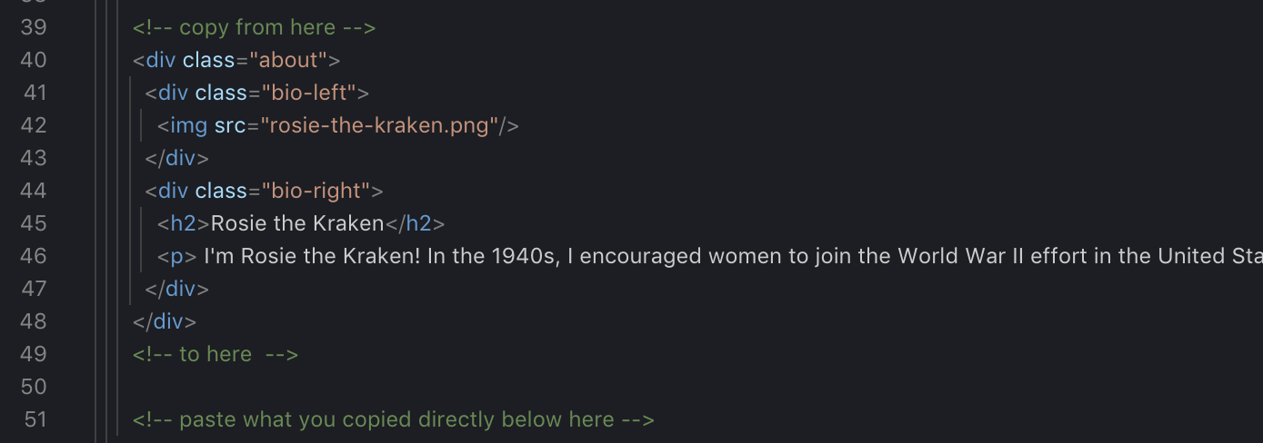
Edit The Project
In index.html, scroll down to line 39.
There is a template for adding your personal bio. Copy lines 40 – 48.
Paste what you copied directly below line 51.
Put your name on line 45. Write a short bio about yourself on line 46. Change the image to be one of yourself, if you wish!
Save your work!

Slide 56
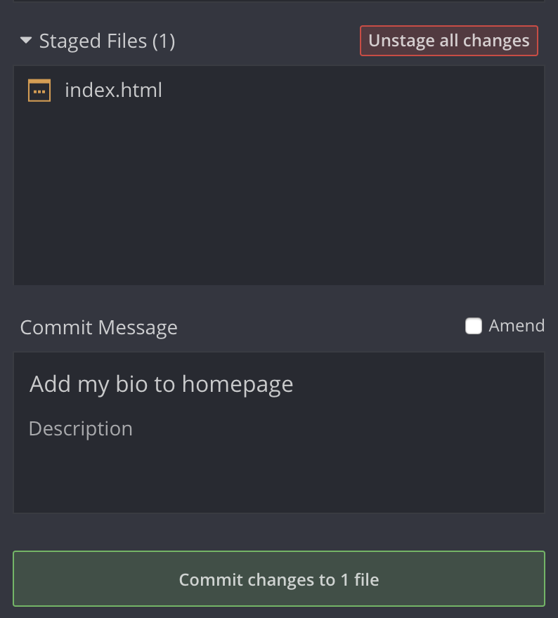
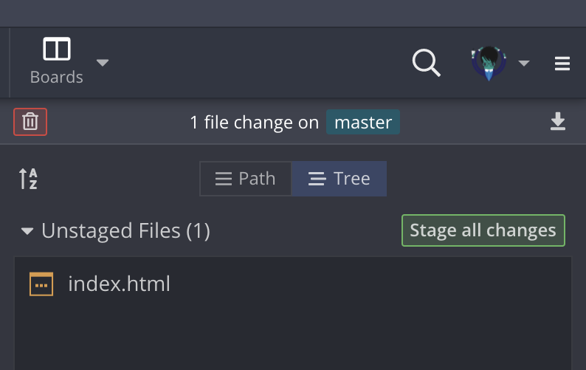
Commit Your Changes
index.html is listed under Unstaged Files. This means you have changes locally, but have not added them to a commit. Select Stage all changes.
Your file has moved from Unstaged Files to Staged Files. Type a descriptive commit message.
Select Commit Changes to 1 file.

Slide 57
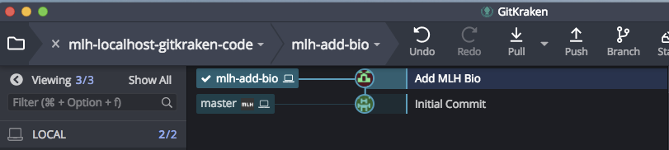
Commit Your Changes
Now you have a new commit in your history!
Click Push to push your changes. This sends them to GitHub.
The first time you push your changes from a new branch, you might see the notification below at the top of GitKraken. Click Submit.

Slide 58
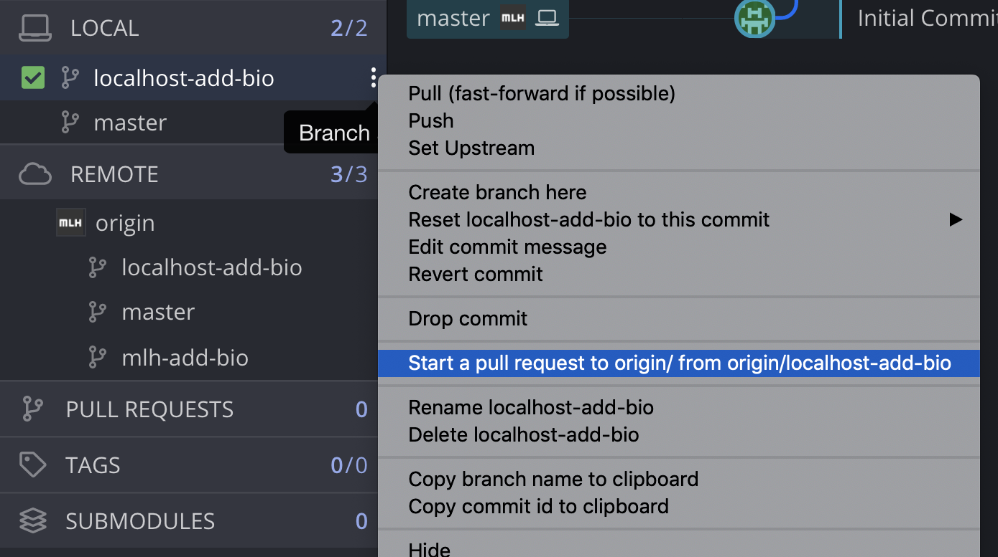
Open a Pull Request
Now you're ready to open a pull request to incorporate your changes. Click the name of your branch.
Click Start a pull request . . .
Note: You might notice that the name of your branch is now listed under LOCAL and REMOTE. You might notice some branches on REMOTE that you don't have locally – those are your teammates' branches!

Slide 59
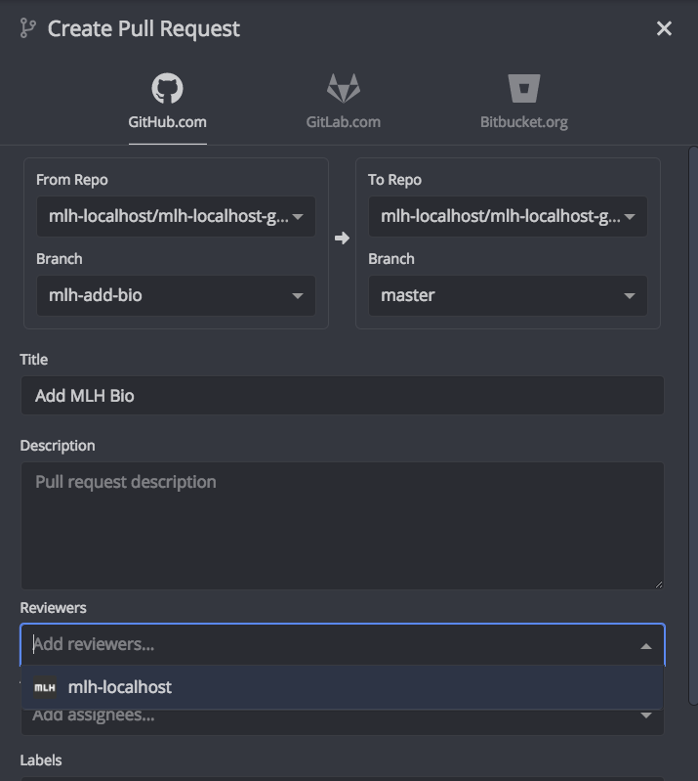
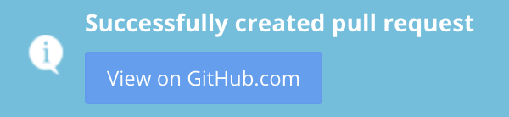
Open a Pull Request
The branch under From Repo is the branch you made at the beginning of the workshop. The branch under To Repo is master. You're asking the owner of the repo to pull your changes into master.
Add a title for your pull request and a brief description.
Assign someone on your team as a reviewer.
Select Create Pull Request and the pop-up below will appear.

Slide 60
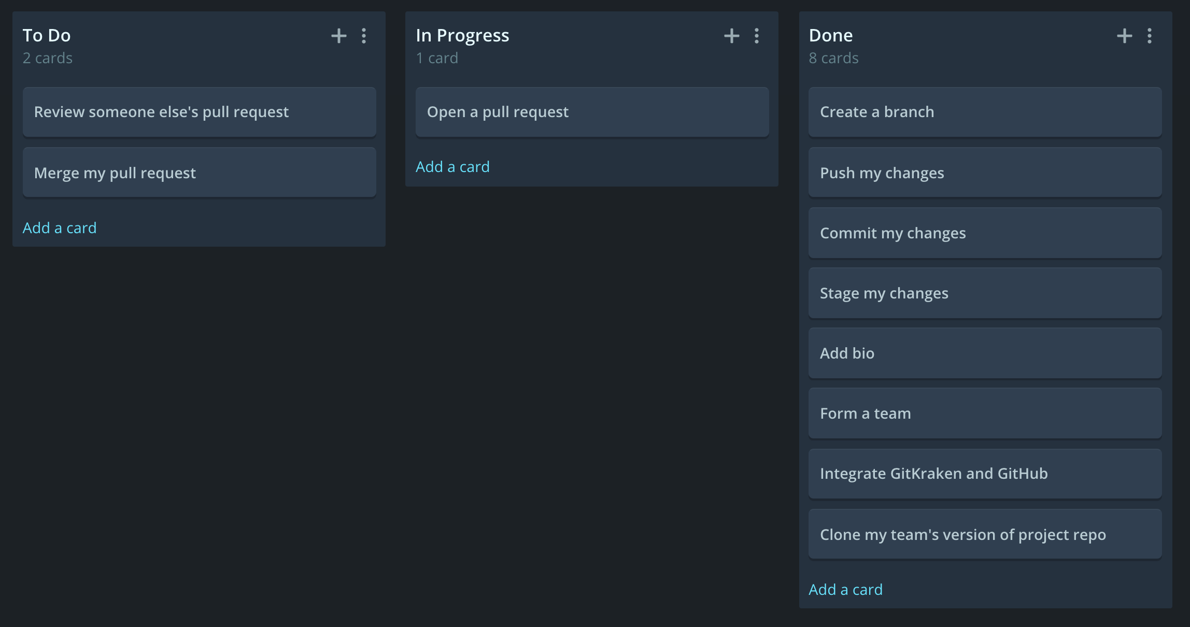
Check Your Progress
Take a moment to switch back to your Glo Board and update your tasks.

Slide 61
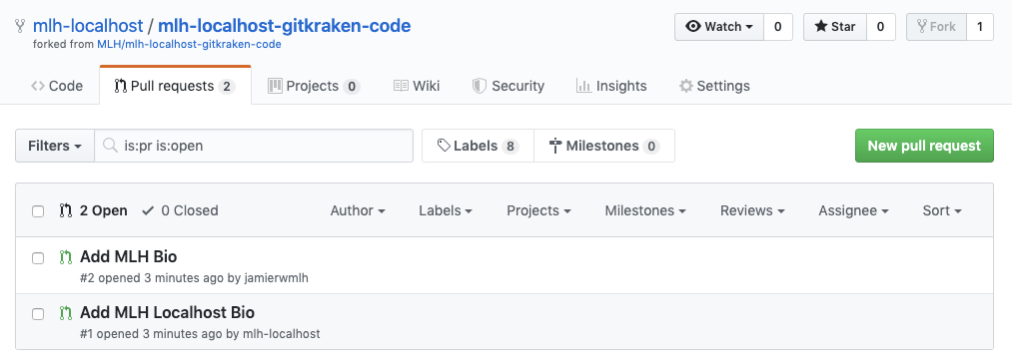
Review Each Other's Pull Requests
If you visit your repo on GitHub and select the Pull Requests tab, you can see your pull request and those of anyone else on your team who has already made their PR.

Slide 62
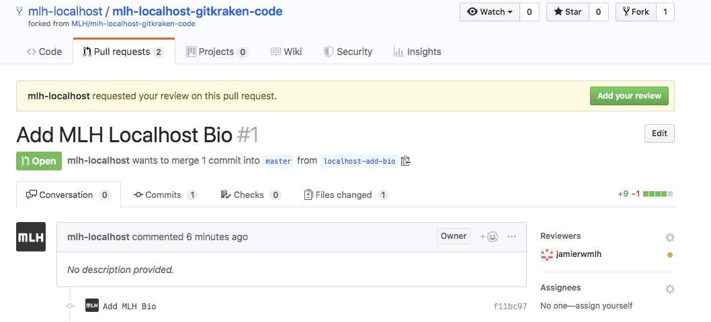
Review Each Other's Pull Requests
Select the pull request of your teammate who assigned you as reviewer. You should see this at the top of the screen:
Select Add your review.

Slide 63
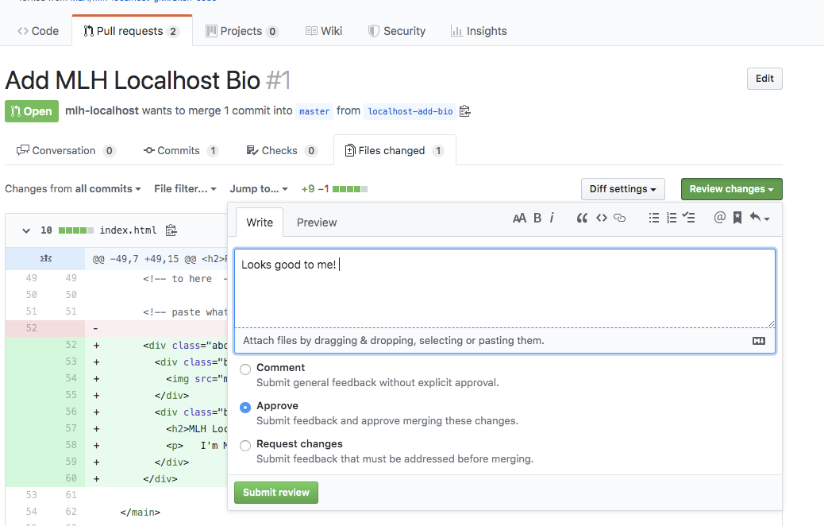
Review Each Other's Pull Requests
You have several options. You should read over their changes, leave a comment, and select Approve if you want them to merge their changes.
Select Submit review when you're done.

Slide 64
Now that you have reviewed each other's changes, it's time to merge everyone's changes into master!
The next steps are very tricky, so start with one team member.

Slide 65



Merge Your Changes
Pick any one of your team members to follow this step. Everyone else should wait for the next few slides. Back in GitKraken, look at the commit tree. Select your branch name and drag it onto master.
When the menu opens, select Merge <your branch name> into master.

Slide 66

Merge Your Changes
Let's take a look at the commit tree!
Notice that at the very bottom, you see master, and you also see master at the top. The higher master has a computer icon, and the lower master has the avatar of the repo's owner.
Any branch that has the computer icon is your local version of the branch. Any branch that has the repo owner's avatar is on the remote.
We want our version of master to be on the remote. Let's do that now!

Slide 67


Merge Your Changes
Double click the local master branch. You will be switched to that branch.
Click Push at the top.
The local version of master disappeared and the remote moved to the top!

Slide 68
Now, everyone else is going to do the same!
There will be a few extra steps.

Slide 69
Merge Your Changes
The steps to merge start the same way. Select your branch name and drag it onto master.
When the menu opens, select Merge <your branch name> into master.

Slide 70

Merge Your Changes
Double click the local master branch. You will be switched to that branch.
Click Push at the top.
You'll get the warning below. This means that master on the remote has new code that yours doesn't. Select Pull (fast-forward if possible).

Slide 71

Merge Your Changes
You'll see these errors! This is because the code you have locally doesn't match the code on master, and Git couldn't determine which one was the correct one. X them out so we can fix it!

Slide 72


Resolve your Merge Conflict
After you dismiss the error messages, you will see the option to view conflict. Select it.
The conflict is in index.html. This is because multiple people edited it at the same time. Click index.html to open the Merge Conflict Editor.

Slide 73

Resolve your Merge Conflict
The code on the left is what you have locally. The code on the right is what's in the remote repository. We want both bios to appear on our website! Click the checkboxes on both sides.
Select Save in the upper right hand corner.

Slide 74


Resolve your Merge Conflict
Now you'll have to commit these changes. Add a commit message and select Commit and Merge.

Slide 75


Resolve your Merge Conflict
Notice now that you have a local version of master again. Select Push.
If everything worked, you'll see the blue success message below. If not, this is likely because you and someone else tried to resolve your conflicts at the same time. Resolve them one at a time following the previous steps.

Slide 76

Check out your Team Page!
Want to see what your team page looks like now that it's done?
In GitKraken, make sure you have the latest version of master.
Right click index.html.
Select Copy file path to clipboard.
In your browser, paste the file path to view your project!

Slide 77
Awesome! Look what you built!

Slide 78
+
Get Crackin' with Git using GitKraken!
Table of Contents
1. Intro to Git and GitHub
2. Set up GitKraken
3. Collaborate!
4. Review and Quiz
5. Wrap Up and Next Steps

Slide 79
+
Get Crackin' with Git using GitKraken!
What You Learned Today
1
A best practice workflow for collaborating using Git
2
How to use GitKraken to make collaboration simple
3
How to use Glo Boards to manage tasks

Slide 80
Review what you learned!
We created a fun quiz to test your knowledge and see what you learned from this workshop.
http://mlhlocal.host/quiz

Slide 81
+
Get Crackin' with Git using GitKraken!
Table of Contents
1. Intro to Git and GitHub
2. Set up GitKraken
3. Collaborate!
4. Review and Quiz
5. Wrap Up and Next Steps

Slide 82

+
Get Crackin' with Git using GitKraken!
Keep Learning
Extra Practice Problem 1:
Deploy your Team Website using GitHub Pages
Extra Practice Problem 2:
Become a GitKraken Ambassador!

Slide 83

Elevate your knowledge and status as a software engineer by joining GitKraken’s community of industry professionals and students. This program will help you increase your software development knowledge, build your professional skills, and provide value to your local tech community. Get support for your events, improve your content, and increase your reach. Plus, there will be plenty of legendary swag along the way!

Slide 84


Slide 85
+
Get Crackin' with Git using GitKraken!
Learning shouldn't stop when the workshop ends...
Check your email for access to:
These workshop slides
Practice problems to keep learning
Deeper dives into key topics
Instructions to join the community
More opportunities from MLH!

Slide 86
THANK YOU!
Your Name
your@email.com
www.gitkraken.com

Slide 87
Get Crackin’ with Git Using GitKraken

